Slide 1
Optical Signatures of Field Line Resonances
D. Megan Gillies¹, David Knudsen¹, Robert Rankin², Steve Milan³, and Eric Donovan¹
February 22nd, 2018
ePOP Science Team Meeting, Saskatoon, SK
¹Department of Physics and Astronomy, University of Calgary, Calgary, Alberta, Canada, ²Department of Physics, University of Alberta, Edmonton, Alberta, Canada, ³Department of Physics, Leicester University, Leicester, UK

Slide 2

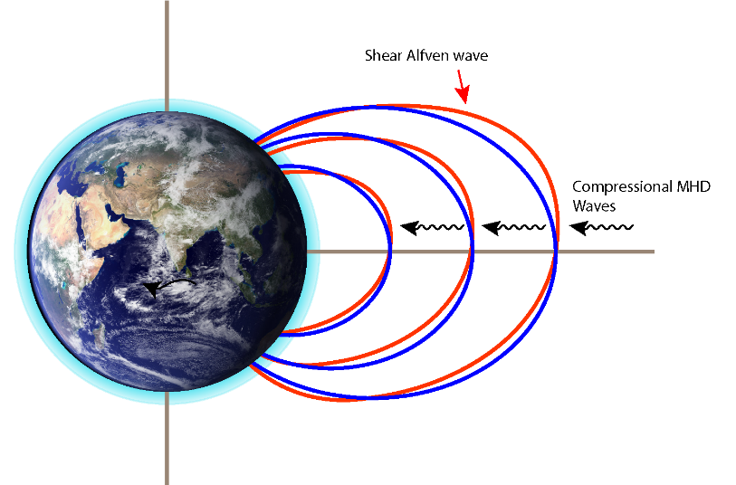
What is a “Field-line resonance?”
MHD theory gives two types: Compressional and Shear Alfvén waves.
According to theory standing shear alfven waves can be excited along geomagnetic field lines.
If the eigenfreqency matches the MHD wave frequency a resonance occurs.
It is a unique phenomenon which can be simultaneously observed in the magnetosphere and by magnetometers on the ground.
Occur with periods on the order of 5-15 minutes at auroral latitudes.
Period increases with latitude.
Often seen in magnetometers near dawn and dusk.
Notes:
So what is a field-line resonance?
FLRs are one of the few phenomena which can be seen simultaneously in the magnetosphere and by magnetometers on the ground. Its characterized by large scale oscillations of the geomagnetic field and has been extensively studies from a standing wave point of view.
For a standing wave analogy consider the geomagnetic field lines to be a violin string with both ends tethered in the ionosphere.
Magnetometers on the ground see FLRS as periodic perturbations of the local magnetic field, generally on the order of 5-10 mins.
The resonance occurs along closed magnetic field lines. Since magnetic field lines become longer as you move higher in altitude, the frequency tends to decrease the further north you go.

Slide 3
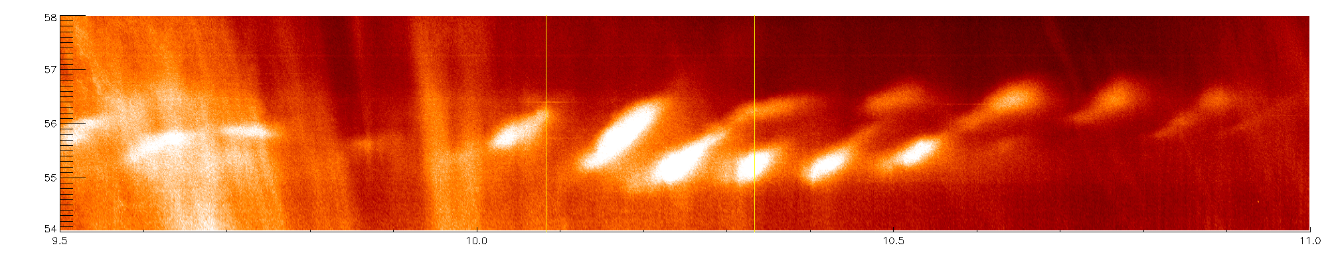
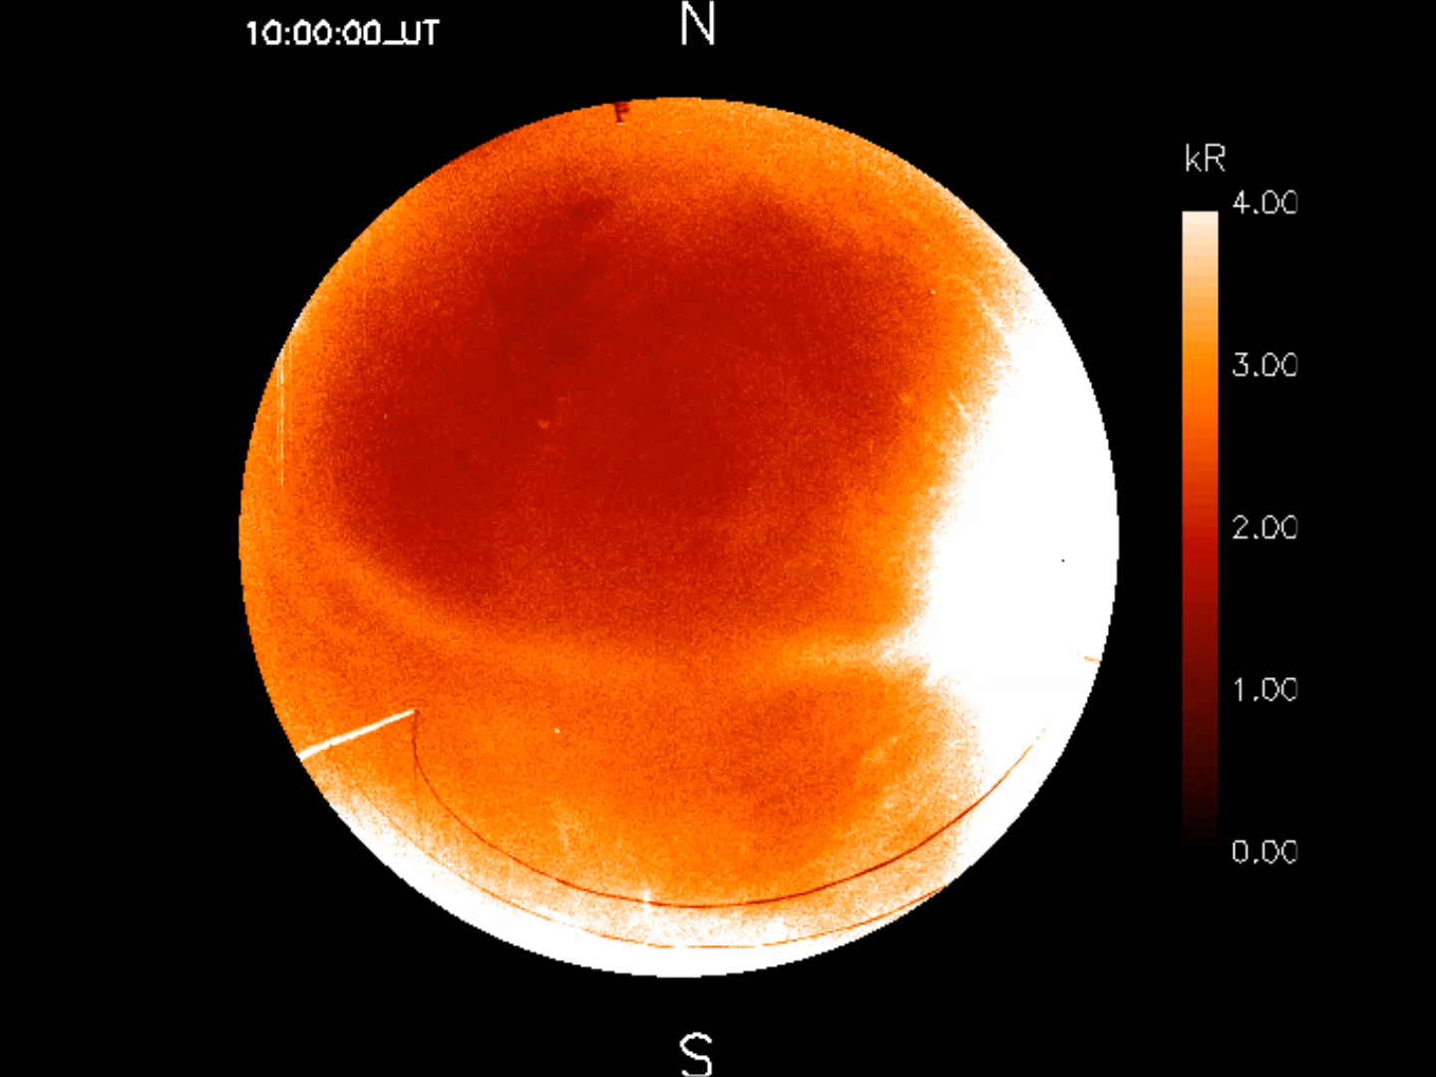
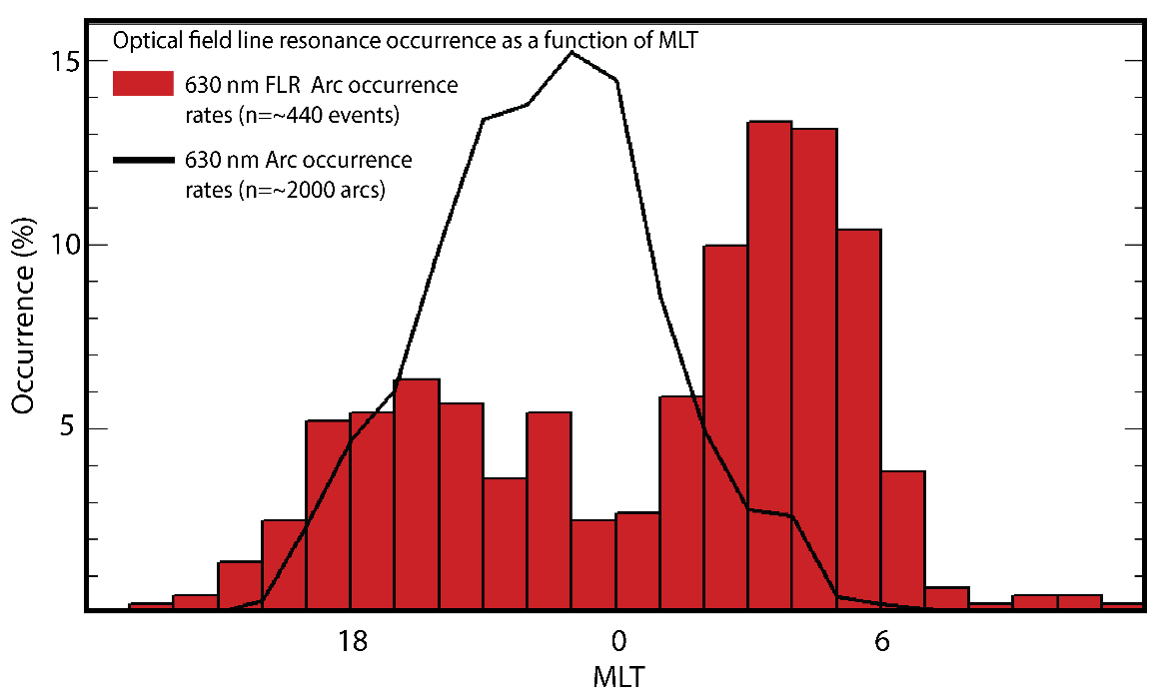
FLR Arcs: Optical Observations
Gillam, Manitoba
February 2nd, 2015
~9-11 UT
FLRs are rare ~5% of the time aurora is present
Dim: ~3 kR
Tend to occur in absence of other auroral morphologies
FLR occurrence peaks just prior to dawn and just after midnight
  Discrete auroral arcs peak just prior to midnight
Notes:
Movie to the bottom left, keogram to the top right on an event in Gillam on Feb 2nd, 2015. Can discus northward propagation , optical brightness (3-4kR)
Stats: So how often do we actually see FLR arcs? Statistically speaking – FLR arcs are incredibly rare. The only occur in ~5% of REGO’s viewing data.
To provide some context with respect to different arc morphologies: single and multiple arc systems are the most frequent. Making up the bulk of auroral observations. Pulsating aurora occurs in about 30% of 577.7 nm auroral observations, sometimes with other auroral morphologies or on its on.
Currently have a data set containing hundreds of this unique arc (of various quality) to study further.
To illustrate that these are in fact a different type of arc system to multiple discrete redline arcs take a look at how these arcs compare to the more standard or typical arc systems. In this plot I’m comparing occurrence rate as a function of mlt of typical redline auroral arcs, such as single and multiple arcs to that of the FLR arcs. As you can see, the regular arcs peak in occurrence just before midnight, dropping off dramatically as you approach dawn. The FLR arcs more likely to be found in the hours leading up to dawn or around dusk.

Slide 4
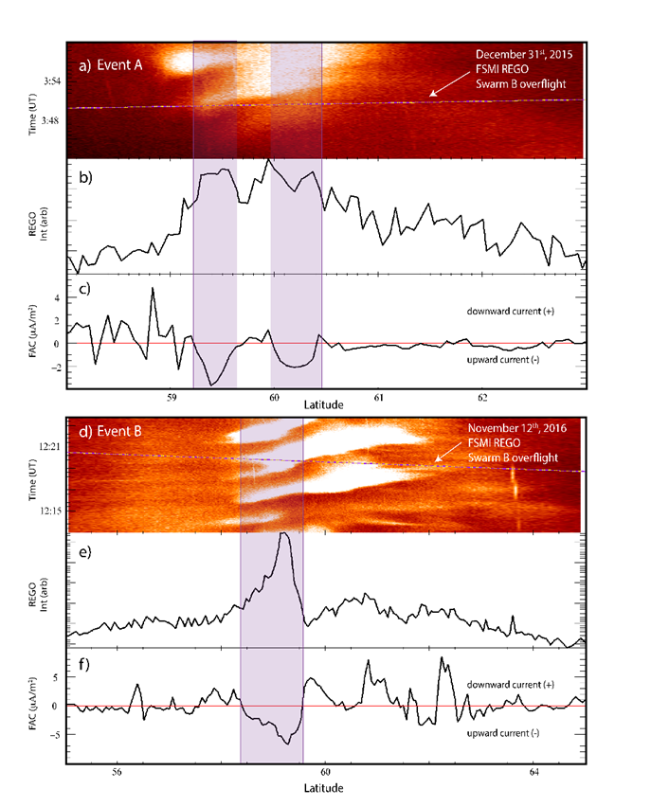
FLR Arcs: In Situ Observations
Swarm provides unprecedented electric field and magnetic field information associated with this particular type of arc.
ePOP will provide invaluable information to current Swarm data sets which will help compare observations to current theoretical models.
Notes:
Figure 5 compares FACs observed during the transit of Swarm-B across two separate 630 nm auroral arcs observed in the FSMI REGO ASI. The event in Figure 5 (panels a-c) occurred on December 31st, 2015 (Event A) at a geographic latitude that assumes a peak emission altitude of 220 km. Figure 5 (d-e) is in the same format as Figure 5 (a-c) and shows an event on 12th November 2016 (Event B). In this case the emission altitude is taken to be 230 km. The FACs, obtained from Swarm-B, are projected downward along the magnetic ﬁeld line to the same altitude. Figure 5a and 5d are satellite-aligned keograms formed by taking a column of pixels along the satellite trajectory and stacking them as a function of time [Gillies et al., 2015]. This enables an estimation of auroral intensity at the position of the spacecraft mapped to the assumed emission altitude. Swarm-B’s northward-traveling trajectory mapped to 220 km (in the case of Event A) or 230 km (event B) as a function of time and latitude is over-plotted with dashed lines. Figure 5(FAC b) shows a trace of the 630 nm intensity along the satellite path. Figure 5(c) displays the FAC traced to the estimated emission altitude. Figure 5 (d-e) is identical for Event B. The time period during which the satellites were within the 630 nm arcs are clearly demarked by the purple boxes in both events. In events A and B a clear and strong upward current within the vicinity of the FLR arcs can be seen, reaching magnitudes of approximately 3 to 6 µA/m². This is in agreement with in situ observations and modelled FAC magnitudes established by Lotko et al. (1998).
Within the arcs, the magnitude of the field line currents is quite high, in this case they are near -5 um/m2. By comparison, typical arcs show much smaller magnitudes, usually ranging about 1-3.
ePOP brings in another opportunity in tandem with the current Swarm satellites:
-ability for conjunction studies with optical data in the southern hemisphere to compliment northern hemisphere
-two point measurements of optical signatures from ground based and space based images
-SEI instrument could provide useful information about ion flow and particle energy in the vicinity of FLR arcs.

