Slide 1
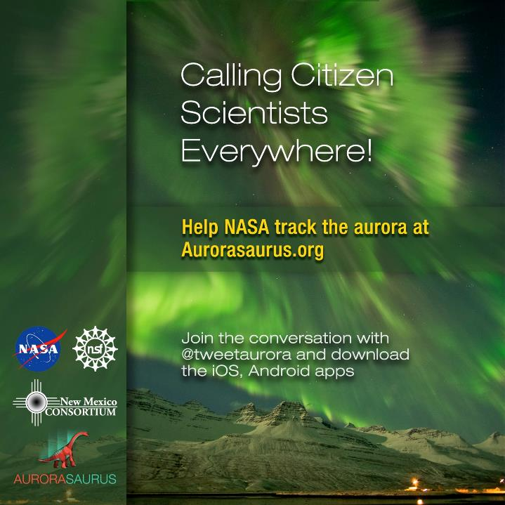
Partner and collaborate with us!
aurorasaurus.info@gmail.com,
fb.com/aurorasaurus.org
Notes:
Also mention points and learning and science applications,
Open-source

Slide 2

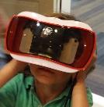
Outline
Why Citizen Science?
What is Aurorasaurus?
What is the problem and why is citizen science well-suited to provide quantitative improvements?
Where are we going next?
Core Team Members: Liz MacDonald, Matt Heavner, Michelle Hall, Andrea Tapia, Burcu Kosar, Nathan Case, Aaluk Edwardson, Kasha Patel, Nick Lalone, Jessica Clayton, Mike Cook, David Kingman
Extended Team: Scientist Network + Local Leaders = Ambassador Network, Advisory Board, Citizen Scientists
Notes:
Public participation in science leads to Disruption
(like Cubesats)
Looking in new and different ways
Proton arc fascinating example.
People saw it and labeled it (which came from a scientist somewhere)
Other scientists say no way.
People say ??? Well, we’ll collect more data.
Other scientists say Wow.
Remind us of the mystery, the limitations of all the structure, jargon, silos
Unique solutions are possible.
How did we get here?
1. Tweets correlate
2. A system is built.
3. Communicate, communicate, communicate. (Newsletters, blog, popular media, scientists)
3. Users were surveyed.
Takes resources
Papers -> postdocs
Social science important
Interdisciplinary work is hard
Sustainment is hard. Looking for help, ideas.
Long term strategy to mainstream
Operational use, another hurdle.
Aurora is a tempermental end result of a complex chain reaction that starts on the sun which streams charged particles through space with varying intensity and all directions. Earth is a wee obstacle to this “space weather”. Like a boulder in a stream most of it stream past us. But then it get super awesome because of magnetic field of the Sun and the Earth which organize the charged particles of both. They couple and they transport around in complex ways… like a person doing the breast stroke is my latest analogy... And all of this is sparsely measured and occurring on multiple scales simulatneously... So that you can’t get both a simple and an accurate forecast. Here’s the person. Here’s their aura. Label the regions.
Here is a tool to use and contribute to. Merge disparate things (need to know clouds, darkness, state of space weather)
Do graphic of breast stroker staying still in a moving pool. Now imagine the pool is a flowing river 93 million miles long. You are always breast stroking and stuck in the same place (by orbital mechanics and gravity and stuff) Pool starts streaming faster, it’s pushing harder, the stroke must get faster... Where can the system respond? Energy storage in the tail helps the stroke. Arms get compressed and much bigger kicks during a storm. Broader energy release. Wider torso.
This is just an analogy, to show energy storage and flow, the way charged particles move is much more complex. Superimpose a 3d bar magnet on top of the breastroker.

Slide 3
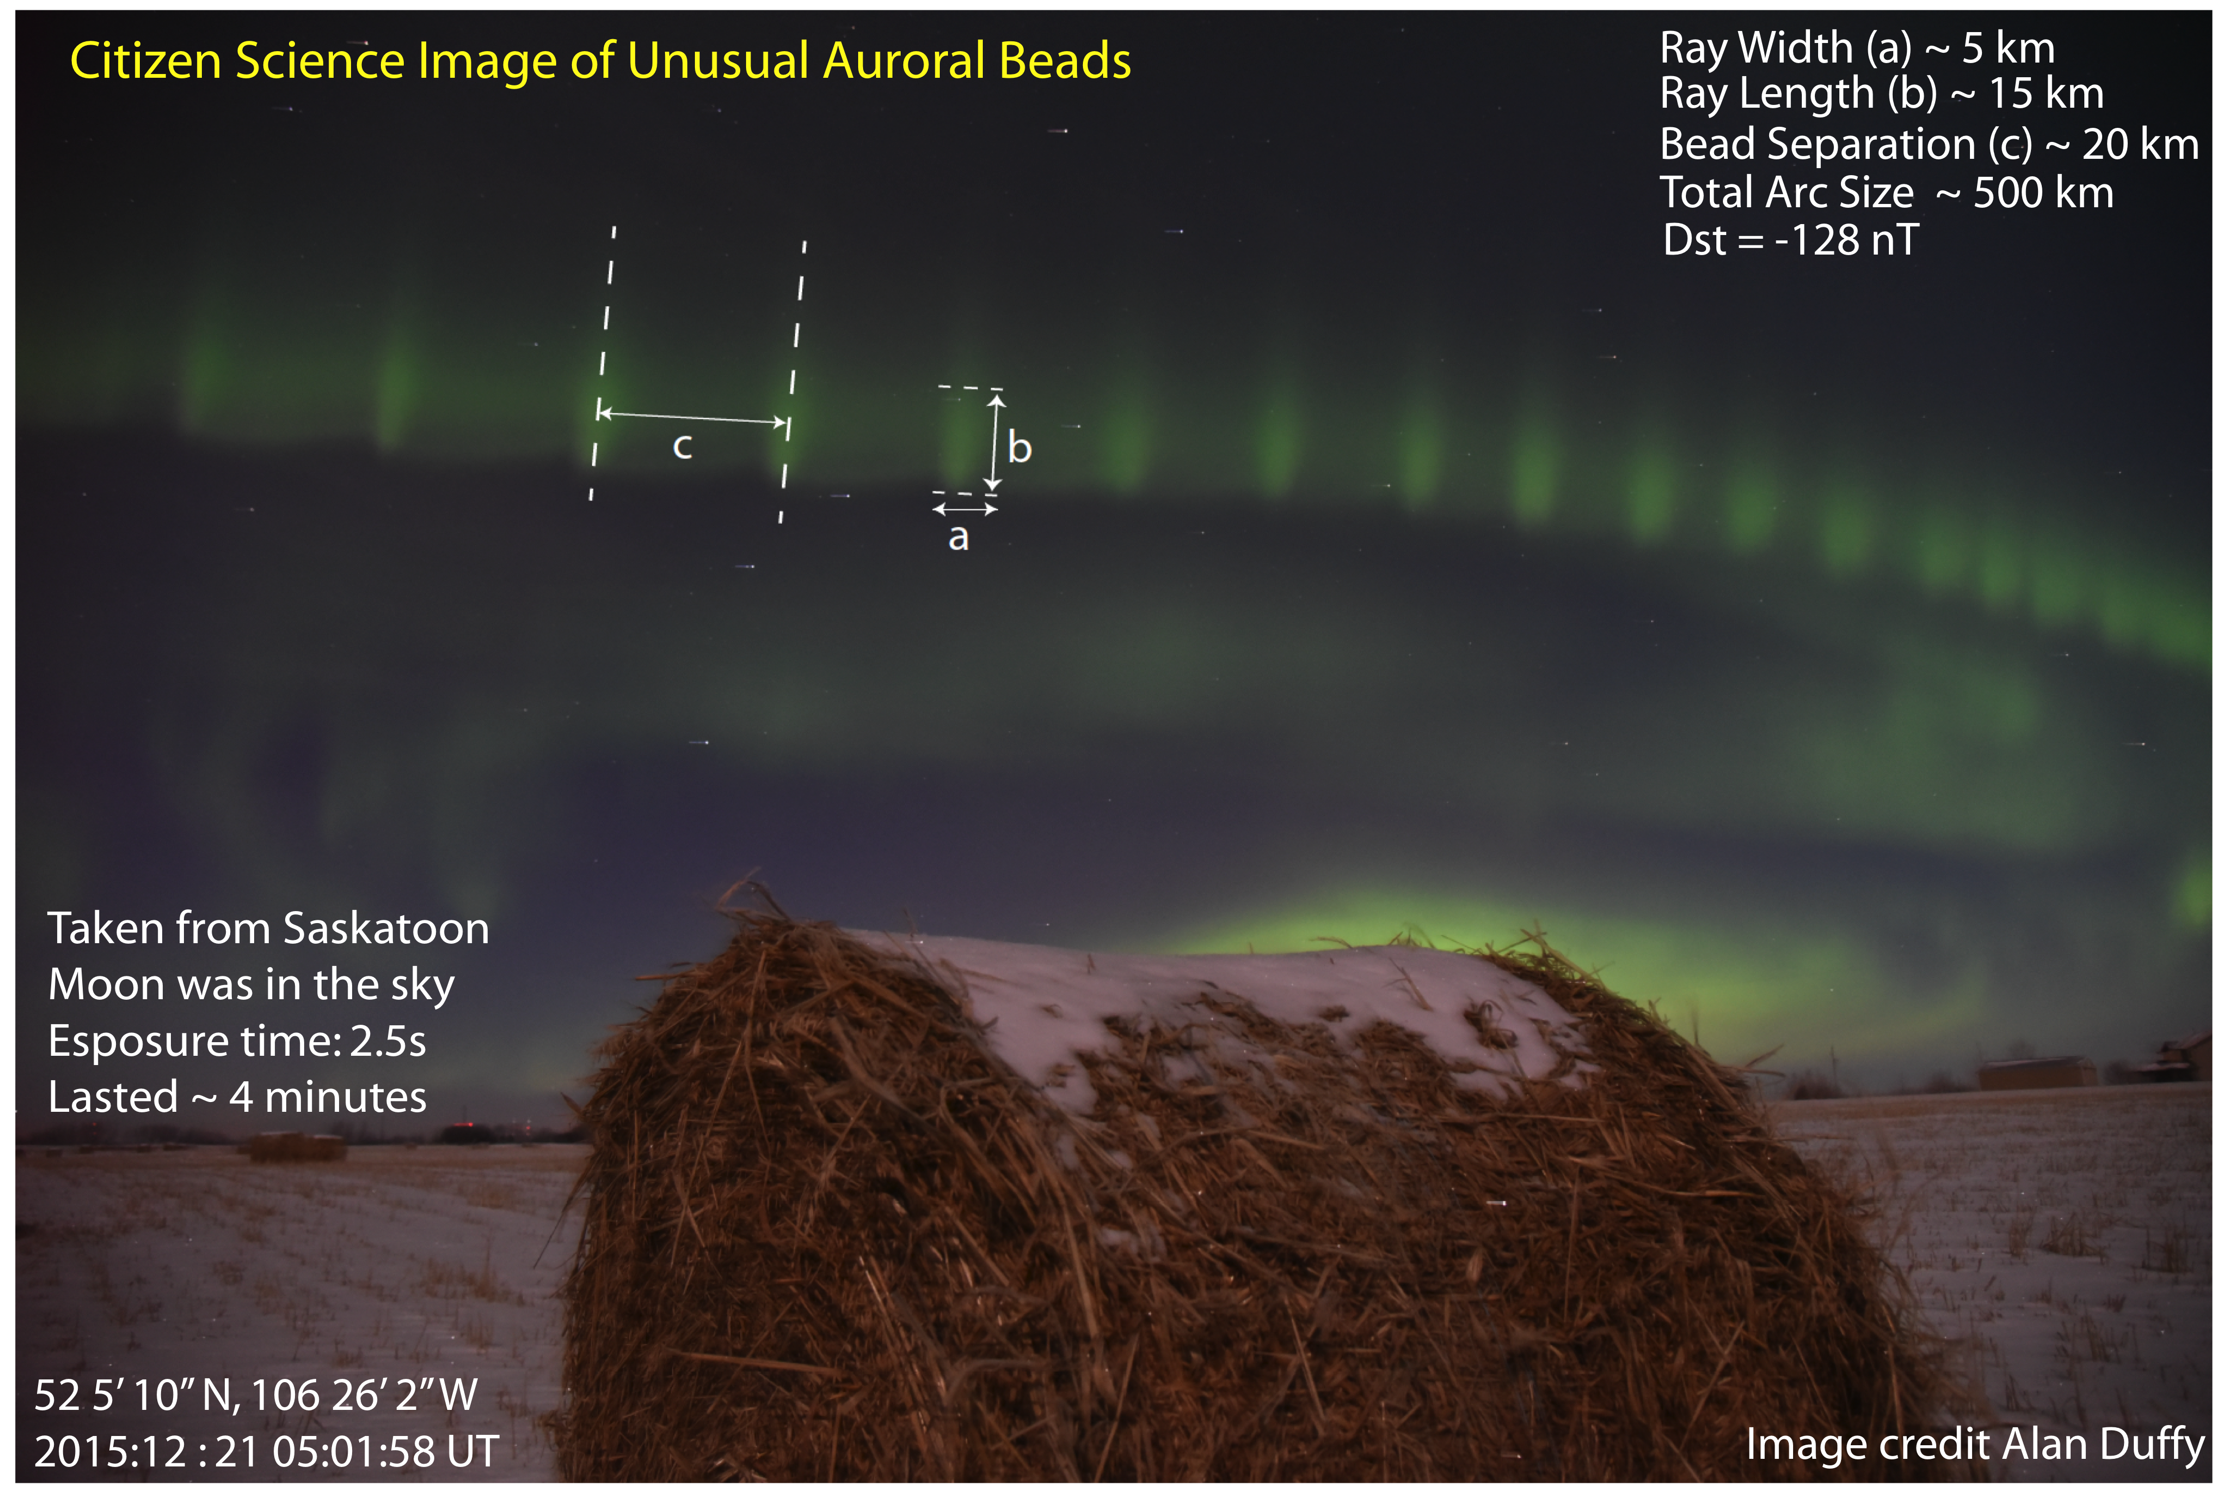
Why citizen science?
Notes:
Slide for Toshi session

Slide 4
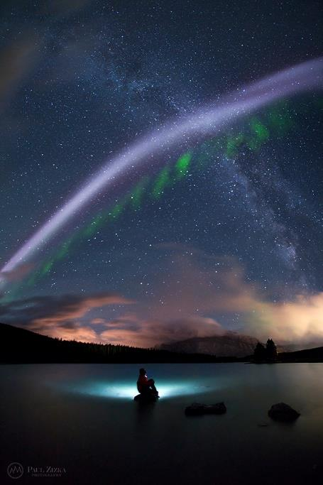
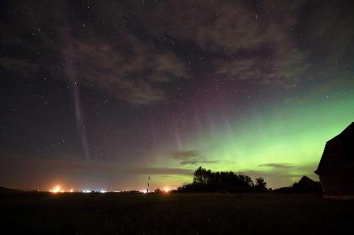
Alberta Aurora Chasers
Steve - The arc formerly known as the proton arc
Through a coordinated effort has been determined to be emission due to a thermally enhanced electron population in a very narrow flow channel below the typical aurora.
John Andersen
Paul Zizka Photography

Slide 5
Alberta Aurora Chasers
Steve - The arc formerly known as the proton arc
Sudden
Thermal
Emission, due to
Velocity
Enhancements
John Andersen
Paul Zizka Photography

Slide 6
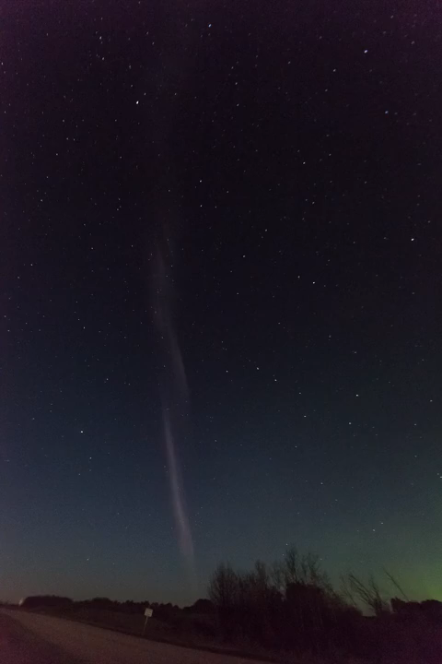
Public participation in science leads to disruption
  Observations of unusual auroral beads on Twitter
  “Proton arc” that is not a proton arc → STEVE
  Traditional science may be missing something
    Limitations of all the structure, jargon, silos
    Complementary to citizen science observations, filtered by wavelength, precise time, timelapse, fisheye view
Credit: Notanee Bourassa, Alberta Aurora Chasers
Notes:
Notanee quote: That was the first time I took my young kids out to see aurora.the display the night has them wanting more. The Steve phenomenon was icing on the cake. Yes please shade with your colleagues working on the event.
(like Cubesats)
People saw something and labeled it (which came from a scientist somewhere)
Other scientists say no way.
People say ??? Well, we’ll collect more data.
Other scientists say Wow.

Slide 7
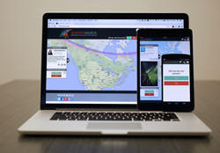
Outcomes:
2000 participants
20 articles
6 articles
Aurorasaurus.org
Apple iOS & Android apps
New global, real-time data sources from citizen scientists and tweets
Alerts of auroral visibility for the public
Launched in 2014
In 2 years, our database has more than 4900 users, more than 2700 reports, and votes on more than 290,000 tweets.
Selected Papers (of >10 submitted so far)
MacDonald, E. A., et al., Aurorasaurus: A citizen science platform for viewing and reporting the aurora, Space Weather, doi: 10.1002/2015SW001214, 2015.
Case, N. A., et al., Mapping Auroral Activity with Twitter, Geophys. Res. Lett., 42, doi:10.1002/2015GL063709, 2015.
Case, N. A., et al., Aurorasaurus and the St Patrick’s Day storm, Astronomy & Geophysics, 56 (3), 2015.
Case, N. A., E. A. MacDonald, and R. Viereck (2016), Using citizen science reports to define the equatorial extent of auroral visibility, Space Weather, 14, doi:10.1002/2015SW001320.
Tapia, A.; Lalone, Nicolas; (2014) Crowdsourcing Rare Events: Using Beauty to Draw Participants into Science and Early Warning Systems, 11th International Conference on Information Systems for Crisis Response and Management (ISCRAM). May 18-21, 2014
Notes:
Turning tweets into knowledge
Update the numbers
1597+ + 40%
1251 + 40%
292000

Slide 8
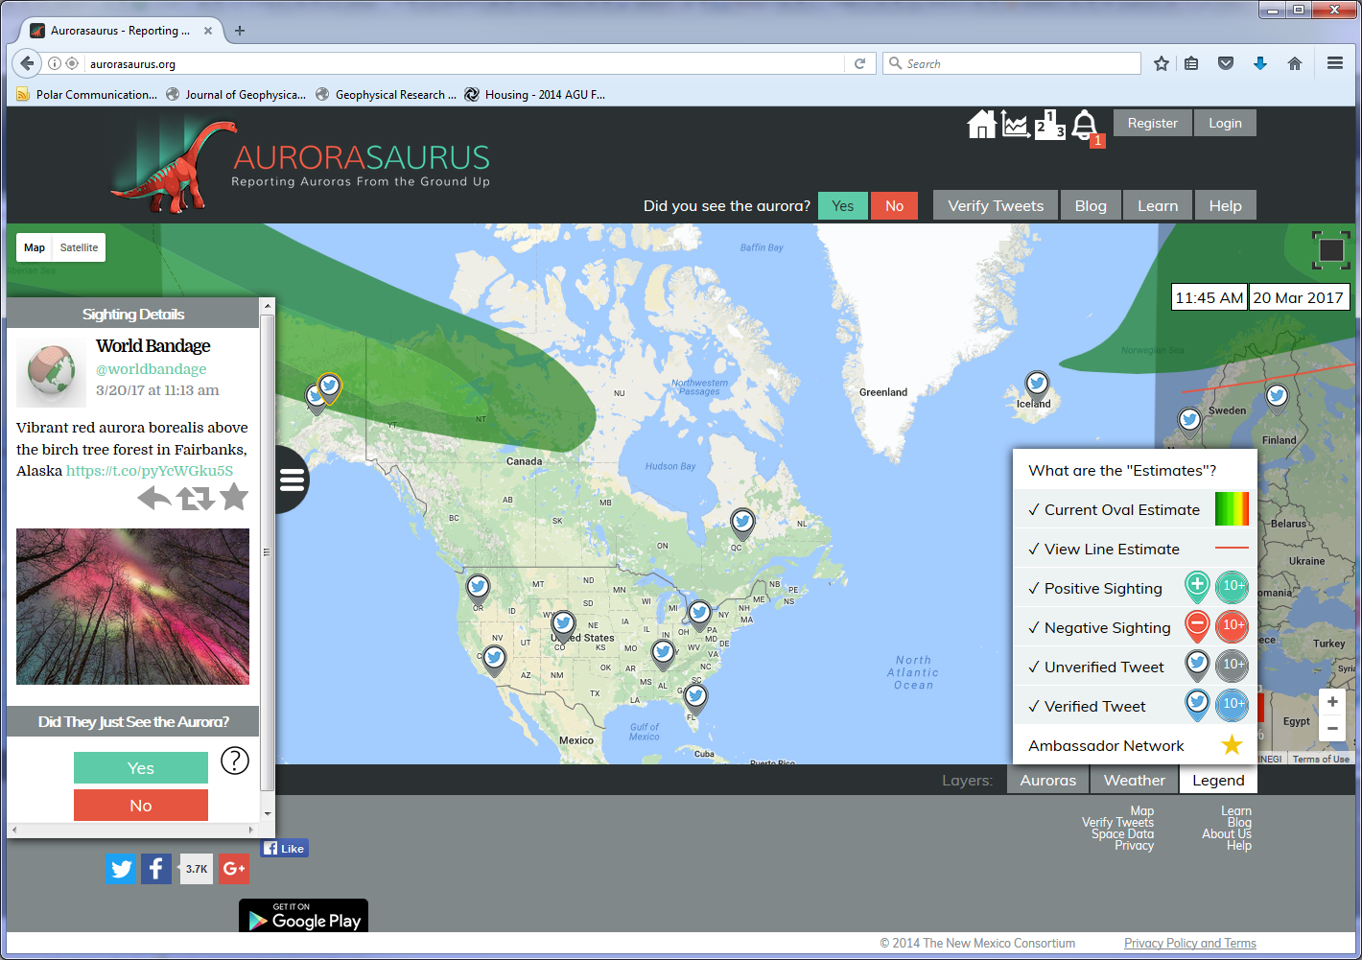

Slide 9
A perfect storm of public participation
Is there a well-posed problem?
  When and where is the aurora (in real-time)? A huge problem, with coarse models, and the tricky science communication.
Is there a public with cognitive surplus and interest?
  Vastly distributed aurora enthusiasts
Can the public participate? (Where, when, how)
  Contribute observations via apps, website, and Twitter (@tweetaurora)
Can public participation yield scientifically valuable results?
  Yes, with data quality controls, new data can improve knowledge
Are there resources for building tools and coordinating?
  NSF INSPIRE award and NASA CAN support, professional development team, postdocs, and outreach coordinators
Is there a spark?
  Turning tweets into knowledge… across many fields scientifically useful and searchable.
Notes:
Still a foreign concept for many
Perfect storm, well suited case. Cannot just say wouldn’t everything be better w citizen science.

Slide 10
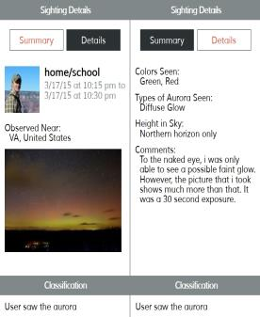
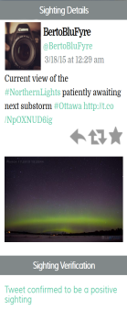
Citizen Science Aurora Data

Slide 11
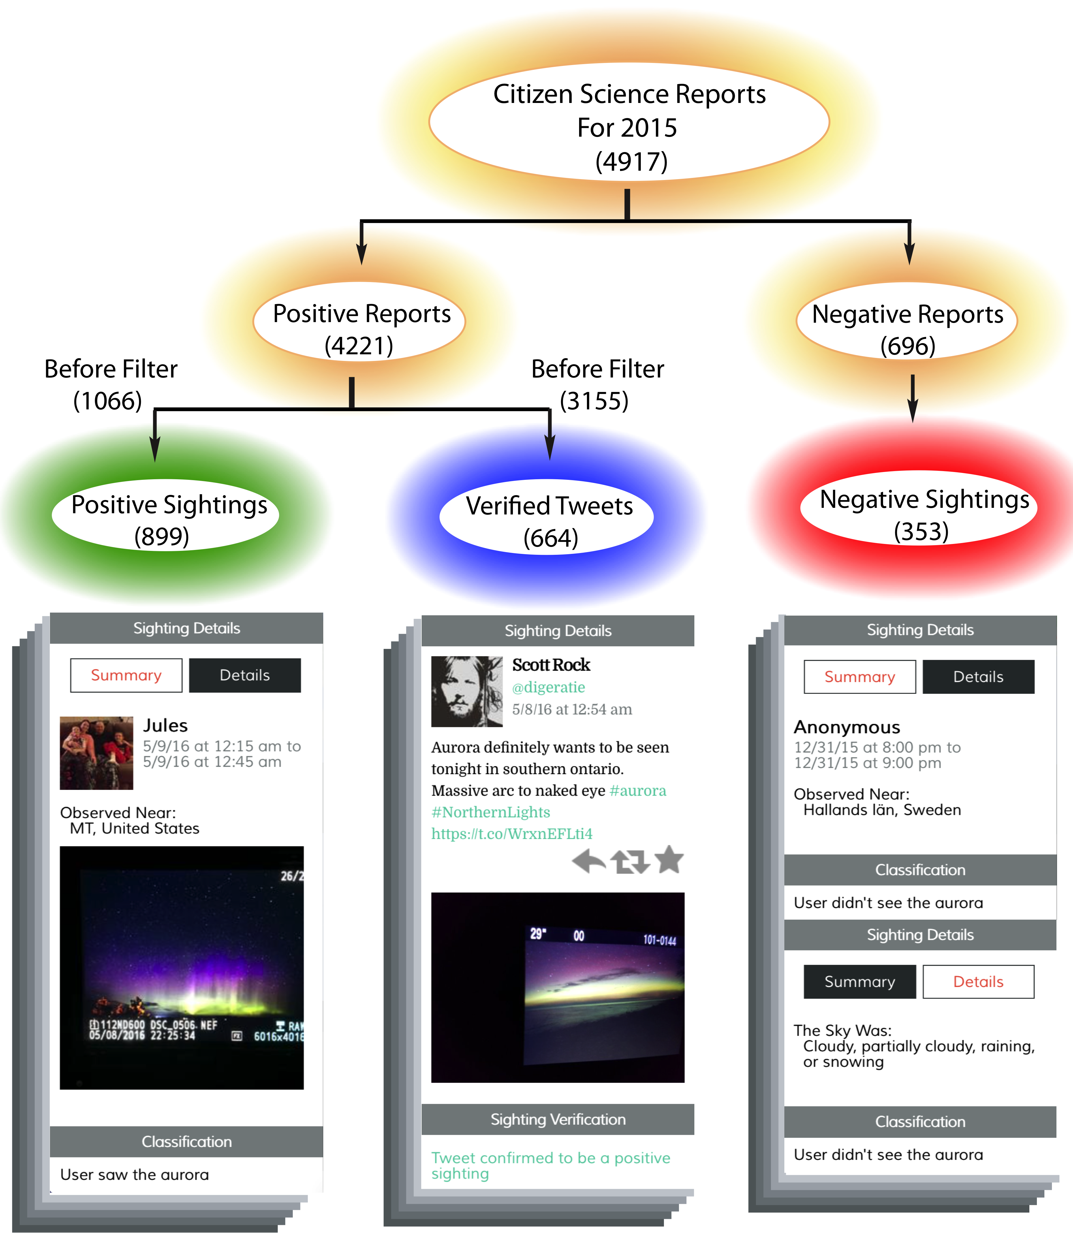
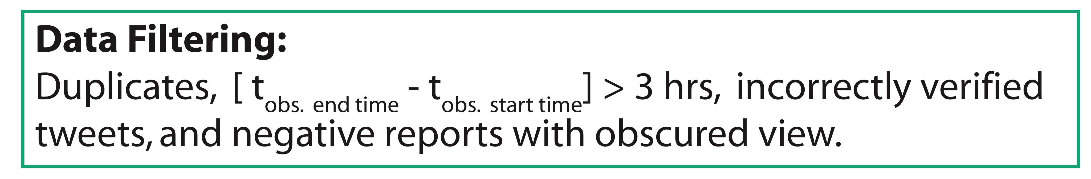
Hybrid system with deliberate posts and ~= # verified signals of opportunity (Twitter)
Database, meta-data rich, participatory

Slide 12
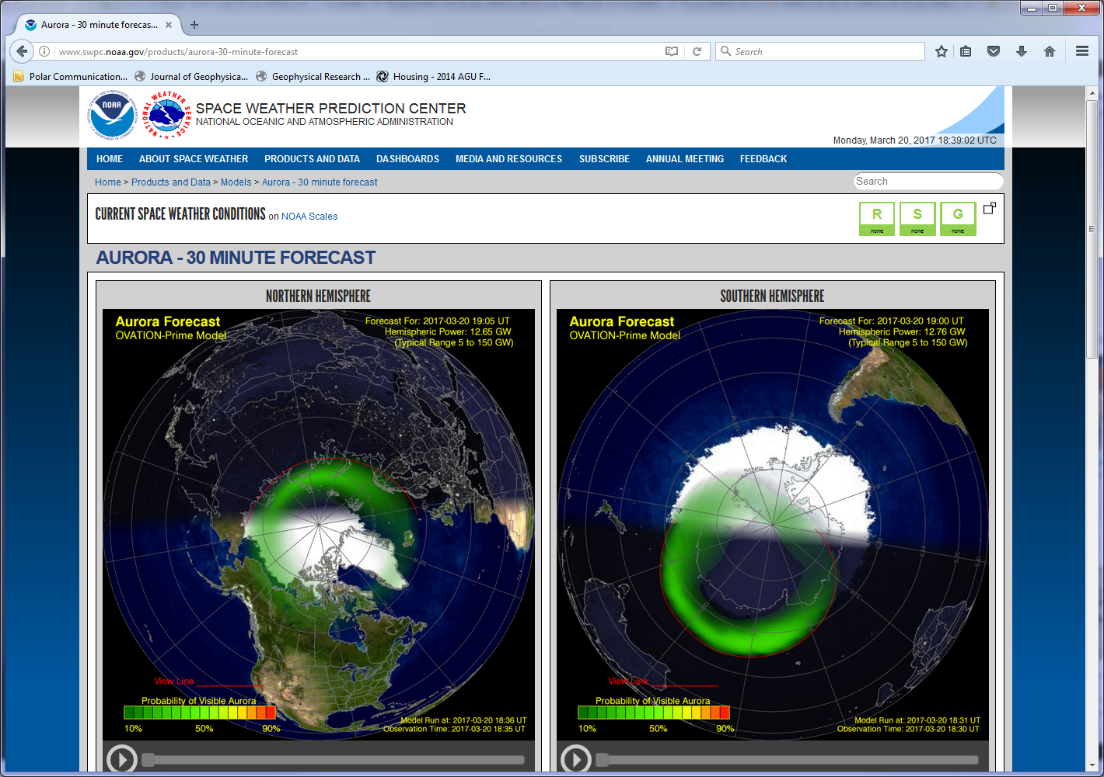

Slide 13
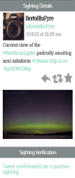

Help us verify the view line
CS: Synthesis, evaluation
Ovation Prime (SWPC)
Probability of visible aurora
Goal: Hybrid forecasting data fusion
MacDonald et al., Space Weather, 2015

Slide 14
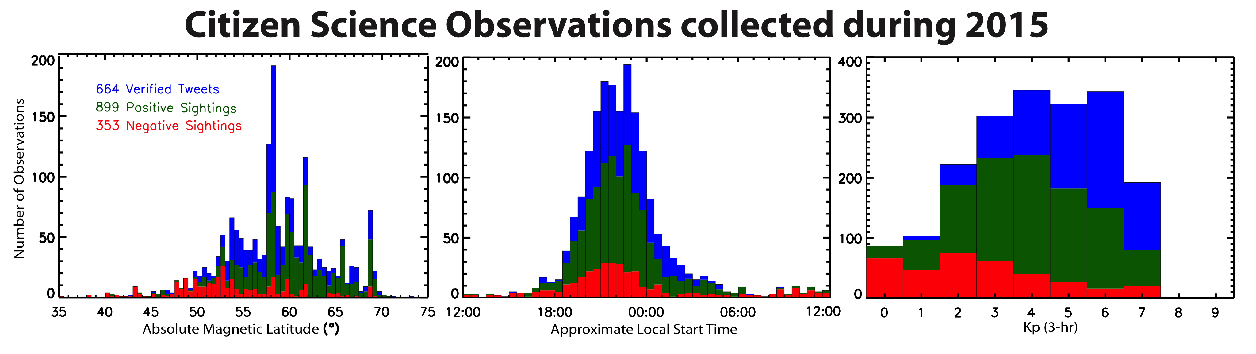
Aurorasaurus observations collected throughout 2015
Reports distributed globally & across activity levels

Slide 15
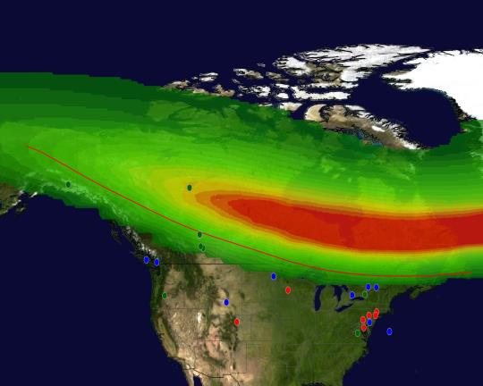
60% of positive observations are below the view line during this event
Aurorasaurus observations provide “ground-truth” for auroral models and estimates.
(left) Example OVATION Prime (2013) output for a 15min period in the St. Patrick’s day (2015) storm. Green and blue dots indicate where the aurora was seen from.
Much further south than the model (and associated view line) predicts. Substorms?
Can test auroral precipitation estimates for visible aurora.
0445 (UTC) on March 18, 2015
Probability of visible aurora
10% 50% 90%
A map of North America with the output from Ovation Prime (2013) overlain. The red line is the NOAA SWPC estimated “view line”. Plotted on top of this are the locations of the Aurorasaurus observations recorded during this particular fifteen minute interval.

Slide 16
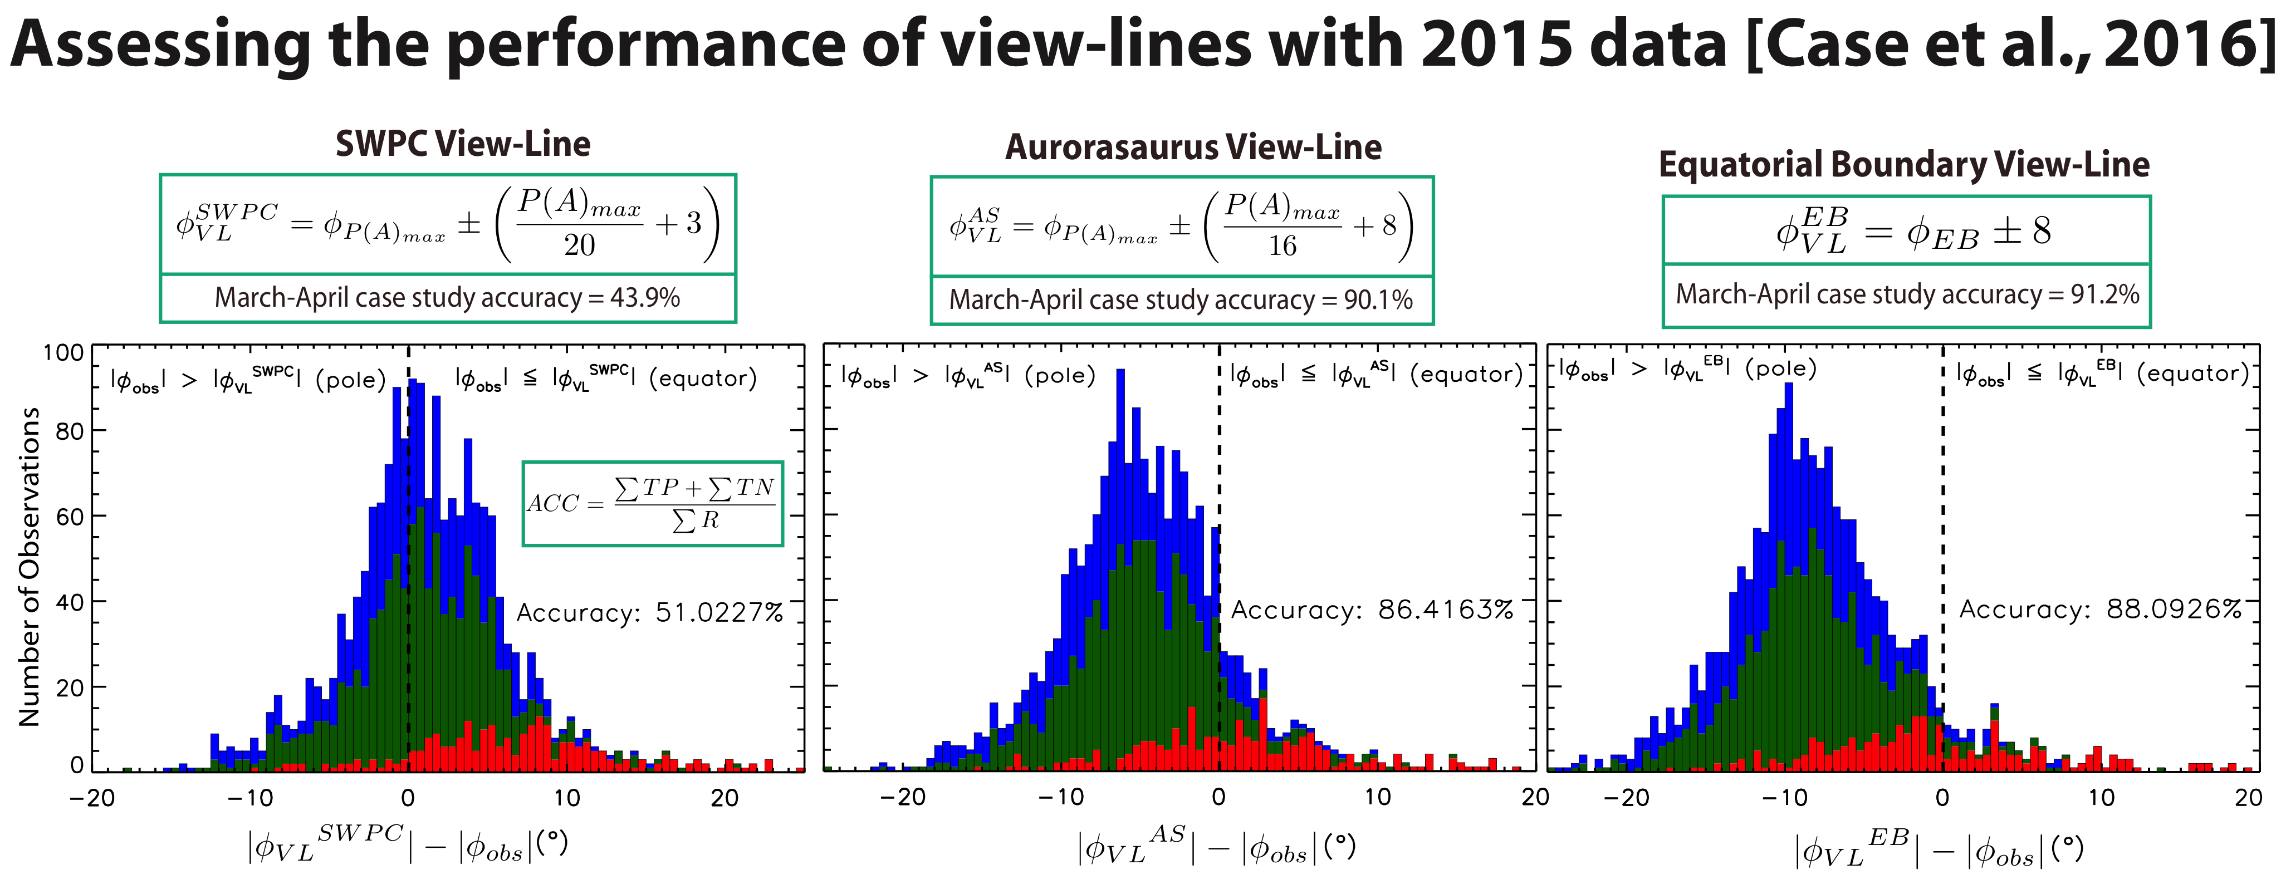
Notes:
• People are successfully seeing aurora equatorward of the viewline 51% of the time (up from 44% for Mar-April case)
• “Aurorasaurus” modified view line is 86% accurate (down from 90% for just March-April)

Slide 17
Morphology varies on multiple scales
Model A: Satellite imagery at ~10 km² resolution
  Model, swath -> global boundary
Model B: Global statistical prediction (~100’s km)
C: Sparse cit. sci. data ~1 km
Ground truth, boundaries more consistent with one model than the other
Model boundary varies by 2-5° (how many km)
Hybrid data fusion from one can help the other
e.g. Citsci data can help Model A fit to global boundary, citsci and satellite data can help overcome statistical model limitations

Slide 18
Aurorasaurus Space Science Results
Rich data is plentiful and can be attained through this platform
Integrated data is actionable to improve alerts for visibility of the aurora

Slide 19
Continued evolution of Aurorasaurus with new technology, open innovation, and interdisciplinary development
  Data assimilation approach
  CAN collaborations around citizen science
    Broader public awareness around observable space weather
  Citizen science being used operationally, globally
  Integrated Maker, IoT activities
  Multiple skins, extensions, and translations of Aurorasaurus
    A version for other phenomena… sprites, NLC’s
    Integrated image analysis citizen science
    Integrated to weather apps
    Integrated community/social platform
Notes:
REWORK FOR SMD AUDIENCE
Shout out to Amy Kaminski

Slide 20


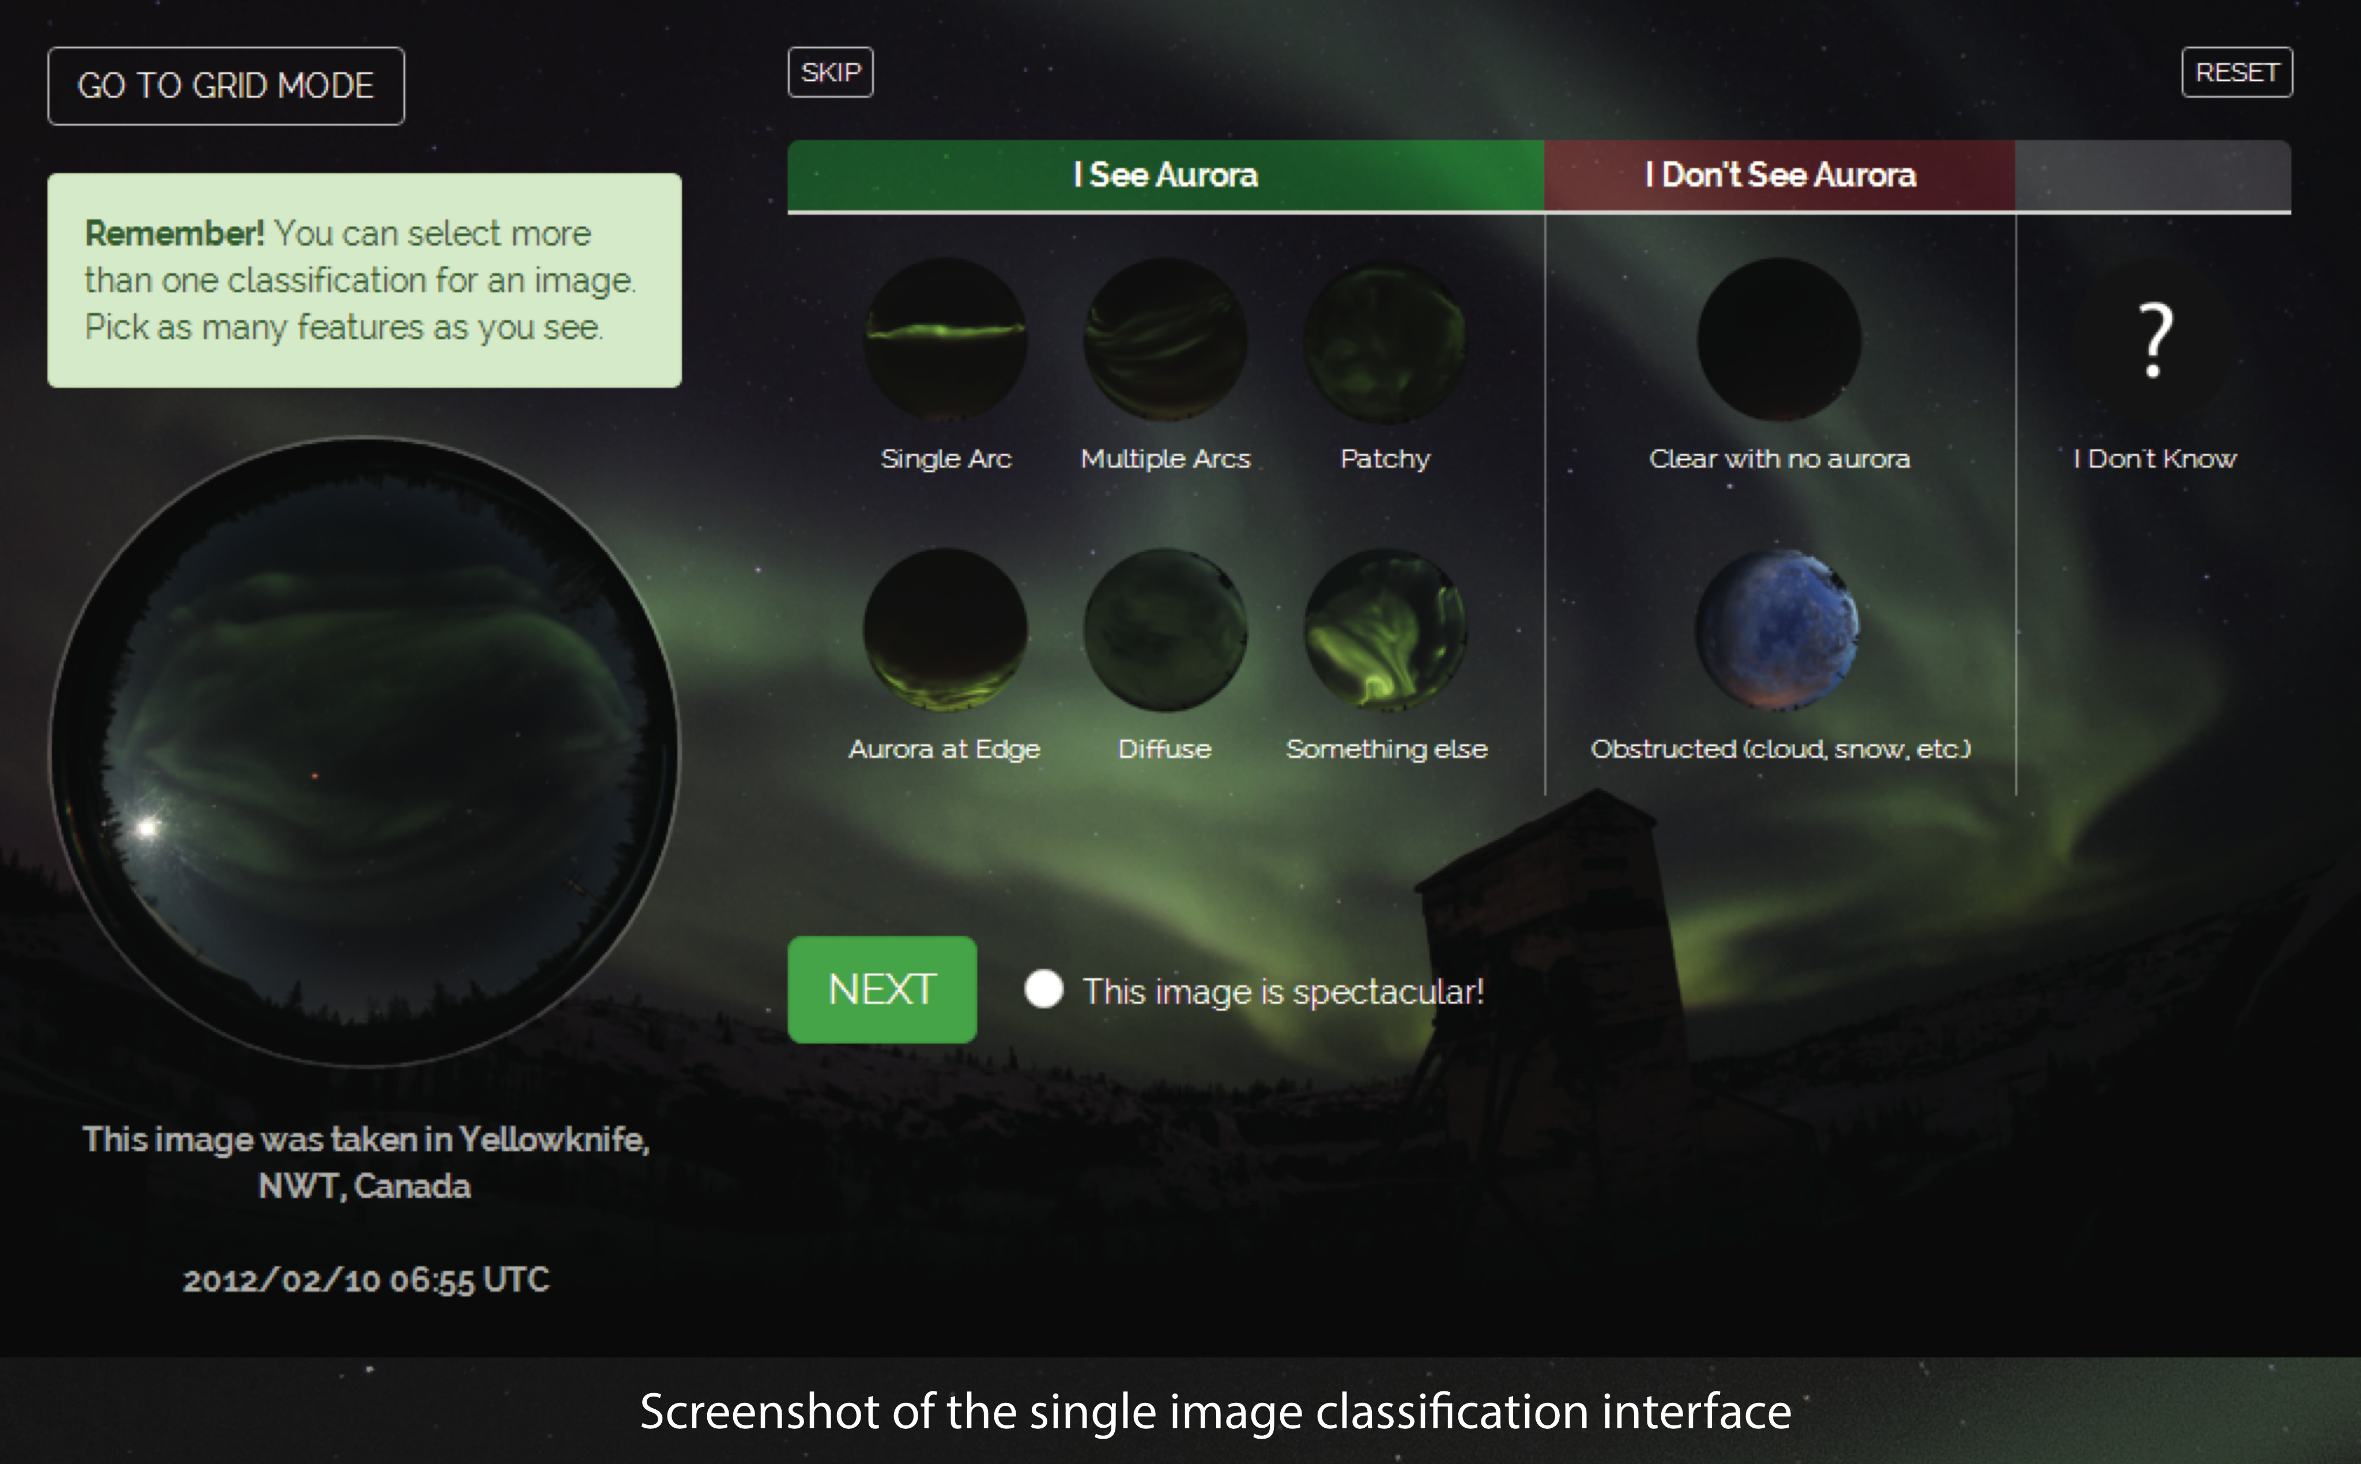
Image classification
Zooniverse has paved the way
Partnering to offer more ways to participate and learn

