Slide 1
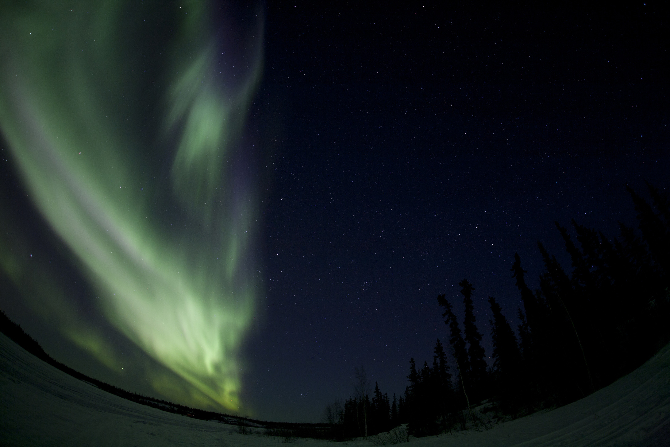
A statistical survey of the 630.0 nm optical signature of periodic auroral arcs resulting from magnetospheric field line resonances
CONNEX Workshop
Banff, AB
May 7-9th, 2018
D. Megan Gillies

Slide 2
CONNEX Science Questions:
Where (in the ionosphere) and when (under what general conditions) do those auroral forms occur?
How often does that particular form occur and what area (lat/lon) does it cover?
What is the current understanding of how those particular auroral forms are produced.
Is there near universal consensus or do important controversies remain?
  if the cause of the auroral form is controversial then what are the controversies?
  why have the controversies not been resolved?
  how will CONNEX resolve those controversies
What are the broader implications for space physics if we understand those processes?
Notes:
As happy as I’d be standing here rattling on about auroral arcs and what not there were some particular goals requested of this talk.

Slide 3
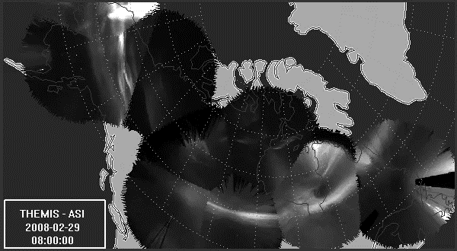
Notes:
Since I’m discussing the aurora, a really good question to have is why would the Connex community be interested in the aurora? The answer to this is simple.
One of Swarm’s mission goals is to map the geomagnetic field and ionospheric current systems.
Magnetic fields produce currents and currents help to drive the aurora. This is a series of images taken in March 2008 using the THEMIS ASI network. This was a particularly good night with clear skies from coast to coast across Canada. In this case we can see large continent-scale aurora mixed in with multiple meso-scale systems. Throughout the hour there are also pockets of small-scale auroral dynamics such as pulsating auroral patches.
Right above this display are massive current and electric field systems at work – driving the dynamic aurora underneath. The aurora provides a visual display of how these systems vary and interact with one another. The current and electric field systems help the auroral science community understand how the two systems interact. This particular display would produce 100s of GW of power, enough
This is what the auroral looks like in “white” light. The redline aurora are incredibly different but just as dynamic in their own way.

Slide 4
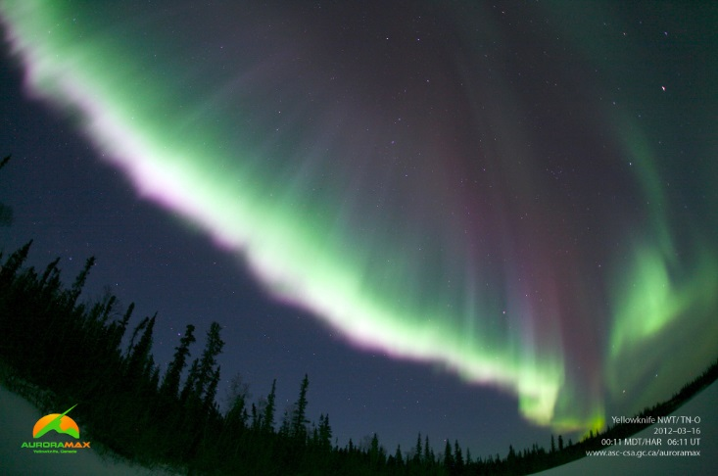
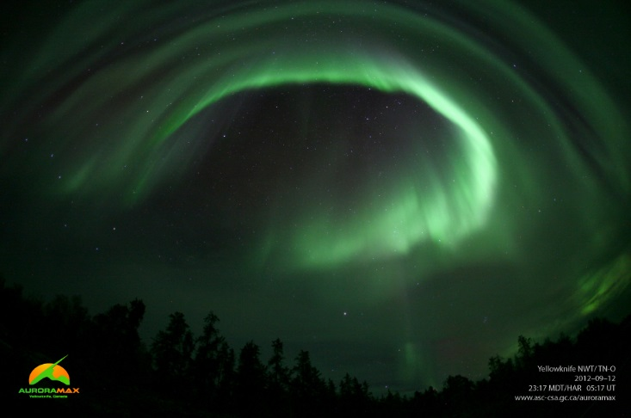
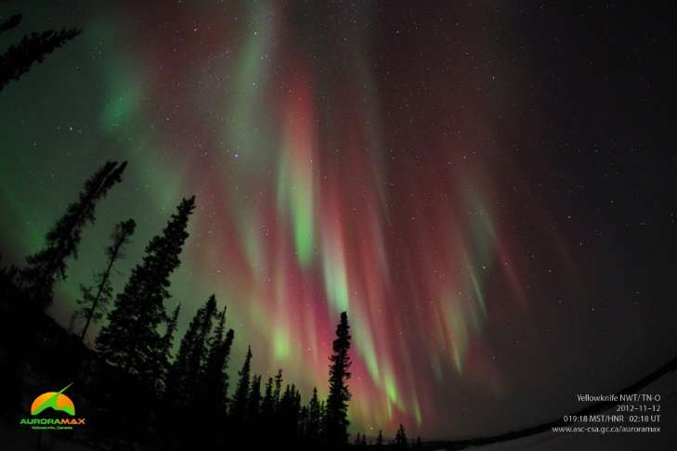
“Quiet” Auroral Arcs
Single Arc Systems
Multiple Arc Systems
Varied Wavelengths
Notes:
The aurora are the end product of interactions within the solar-terrestrial environment. They come in all shapes and sizes. Many of you may recognise these images of auroral arcs. These images are typical of what you would see in a magazine or when you think about the aurora. They come in all shapes and size. Here we are looking at a single banded auroral arc. In the middle we have multiple green bands of auroral arcs, you will here more about this type of system from Jiashu Wu in the next presentation. Although visually we tend to see the ‘typical’ green aurora, this image here on the right shows the larger scale of auroral wavelengths that are created. This images shows an auroral curtain with the bright 577 nm green emission along the base and the fainter 630 nm red emission extending to high altitudes. This fainter redline aurora will be the primary focus of my talk but I’ll get to that in a minute.

Slide 5
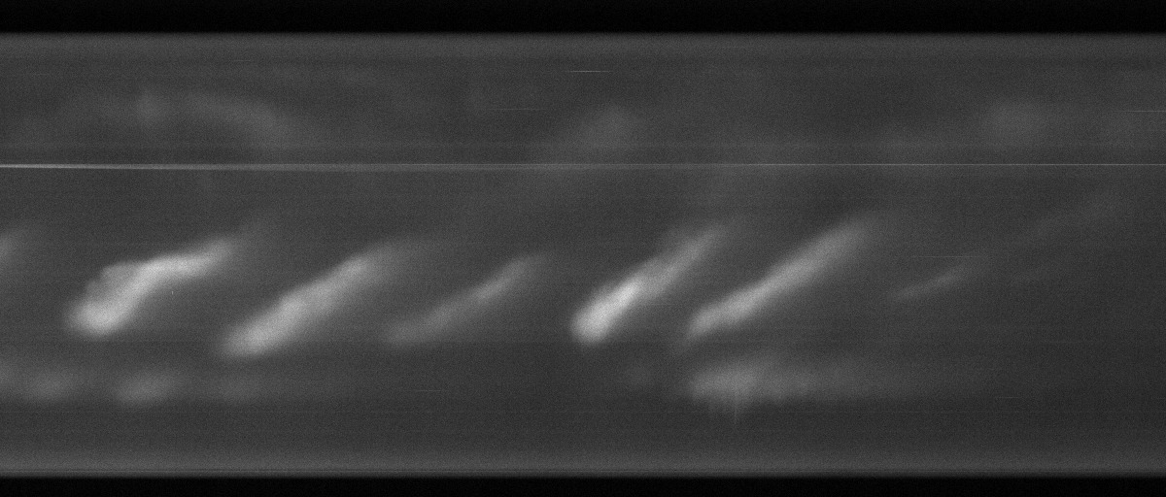
“Quiet” Auroral Arcs
Single Arc Systems
Multiple Arc Systems
Field line resonance Arc Systems
Varied Wavelengths
Notes:
The aurora are the end product of interactions within the solar-terrestrial environment. They come in all shapes and sizes. Many of you may recognise these images of auroral arcs. These images are typical of what you would see in a magazine or when you think about the aurora. They come in all shapes and size. Here we are looking at a single banded auroral arc. In the middle we have multiple green bands of auroral arcs, you will here more about this type of system from Jiashu Wu in the next presentation. Although visually we tend to see the ‘typical’ green aurora, this image here on the right shows the larger scale of auroral wavelengths that are created. This images shows an auroral curtain with the bright 577 nm green emission along the base and the fainter 630 nm red emission extending to high altitudes. This fainter redline aurora will be the primary focus of my talk but I’ll get to that in a minute.

Slide 6
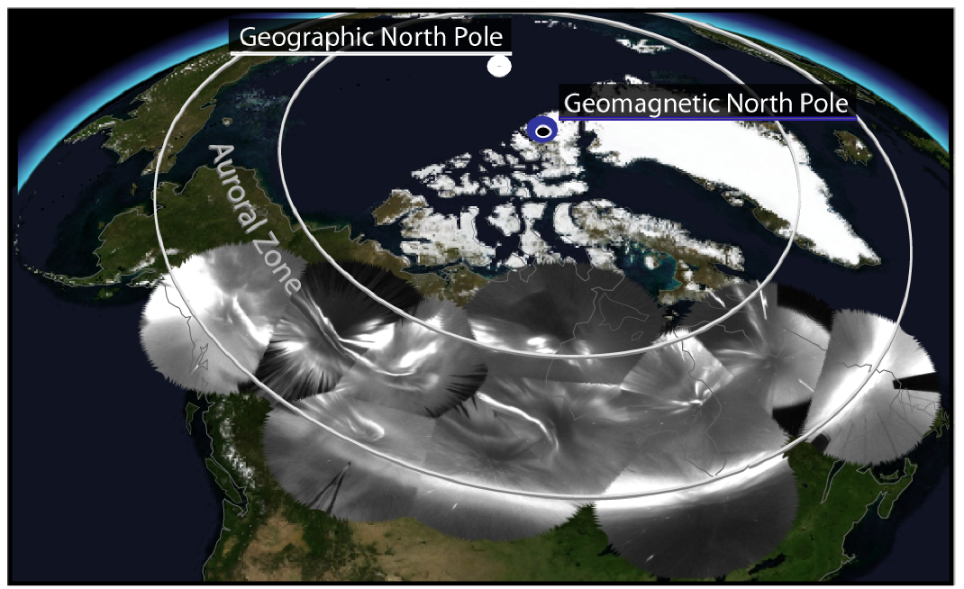
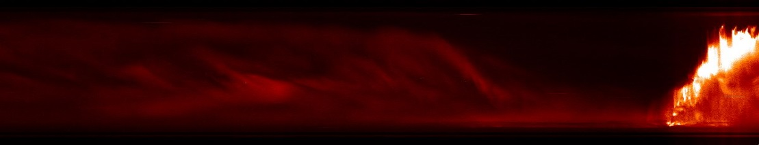
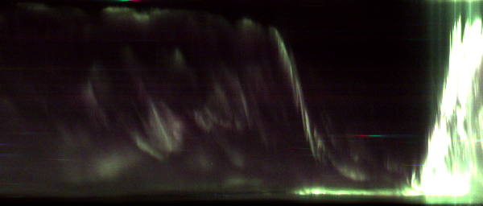
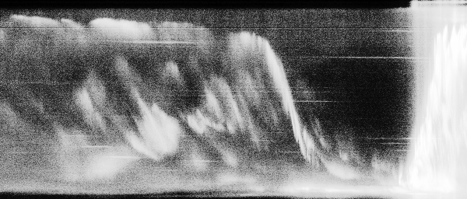
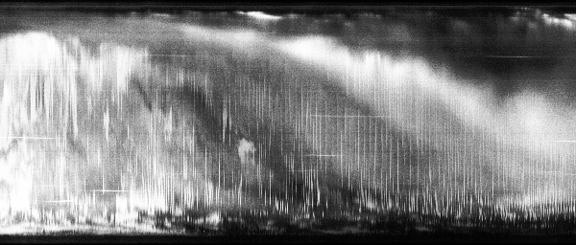
Tools we can use to look at the Aurora: Ground-based All-sky imaging networks
REGO – 2015_02_18 @ 5 UT
Fort Smith
λ = 630.0 nm
~230 km
Rainbow
THEMIS
“White” light
~110 km
THEMIS – 2016_02_09 @ 12 UT
Fort Yukon
Notes:
Keograms are a useful data product when studying the aurora. They give an estimate of auroral behavior as a function of time. North is towards the top of each panel and south towards the bottom. I’m just going to show you an example of how the dynamics we saw in the previous slides vary with different optical systems.
This event in the top right corner shows aurora with the REGO redline cameras, the rainbow cameras, and the THEMIS white light camera. Redline responds to lower energy precipitation at higher altitudes 150-upwards of 400km. “White light” is dominated by the green line which dominated by higher energy precipitation at lower altitudes 100-120km. In these keograms we can see an arc system. In the bottom panel we can see multiple arcs systems overlaid with pulsating auroral patches. Pulsating patches have this distinct zebra pattern associated with the patches turning on and off in time.
The video on the previous slide was a time lapse of just one hour. During that time period we saw each of these auroral processes. These are the most commonly identified auroral morphologies.
I’m not actually going to be talking about any of these arc systems. Jiashu has the multiple arc system covered in the next talk and Jun will be discussing Pulsating aurora in the talk after hers. What I’m going to be talking about is a completely different type of auroral arc; namely, those associated with FLR.

Slide 7
“A survey of quiet auroral arc orientation and the effects of the interplanetary magnetic field”
D. M. Gillies, D. J. Knudsen, E. F. Donovan, E. L. Spanswick, C. Hansen, D. Keating, S. Erion
doi.org/10.1002/2013JA019469
Why? Observations of quiet (stable) auroral arc morphology place strong constraints on candidate arc theories.
Time span: 2007-2010
Instrument: THEMIS
Identified in the survey:
  Single and Multiple elongated (east-west) arcs
  Over 7500 images were manually classified at 10 minute intervals

Slide 8
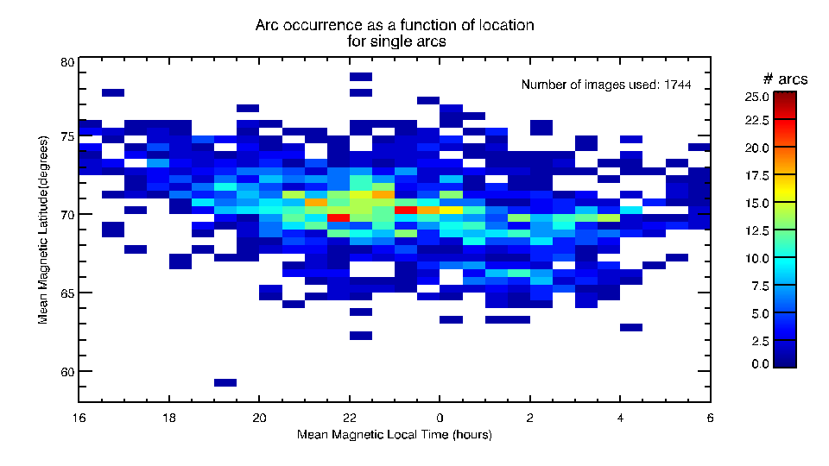
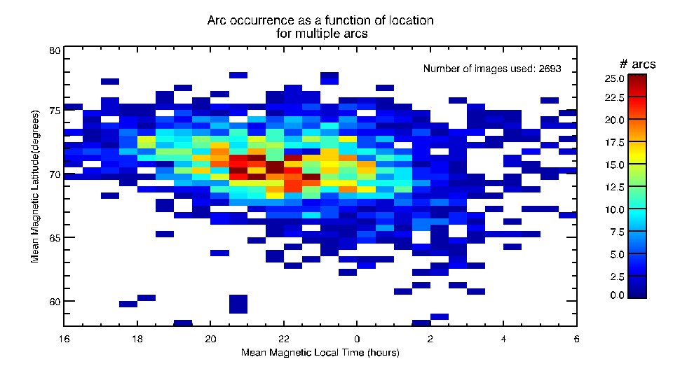
CQ: How often do “quiet arcs” occur and what area (lat/lon) does it cover?
Single Arcs
80
70
60
MLat (deg)
Multiple Arcs
18 0 6
80
70
60
Magnetic Local Time (hours)
MLat (deg)
18 0 6
Magnetic Local Time (hours)

Slide 9
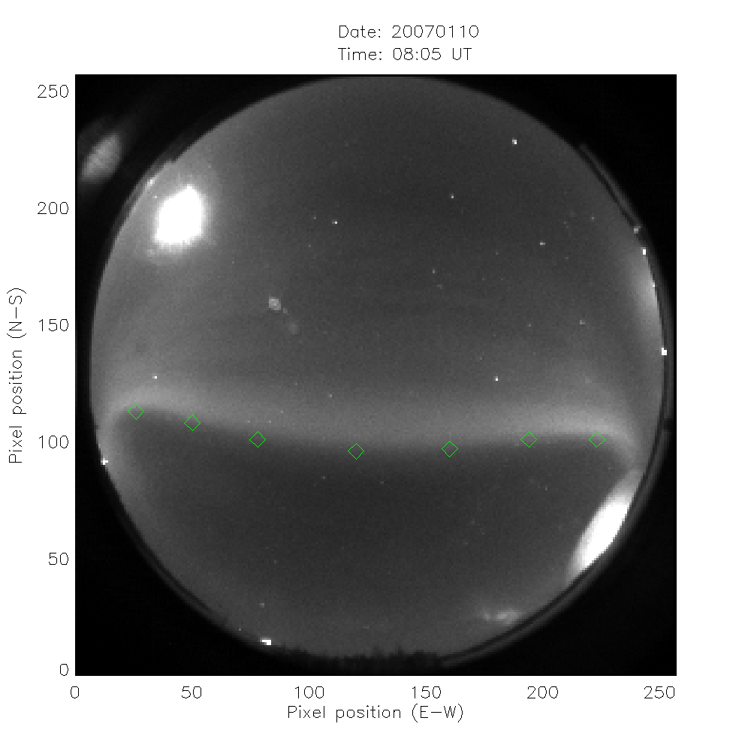
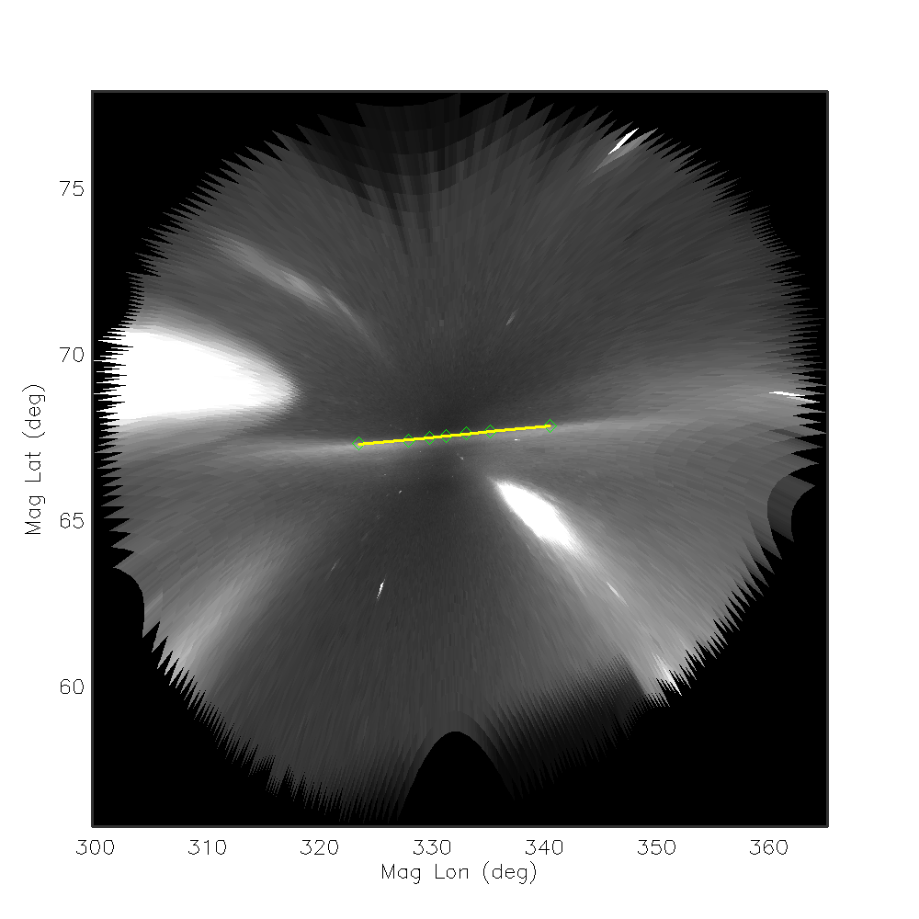
Once we identified arcs we looked at their structure and behaviour
Specifically: we wanted to investigate how they align themselves with the magnetic field

Slide 10
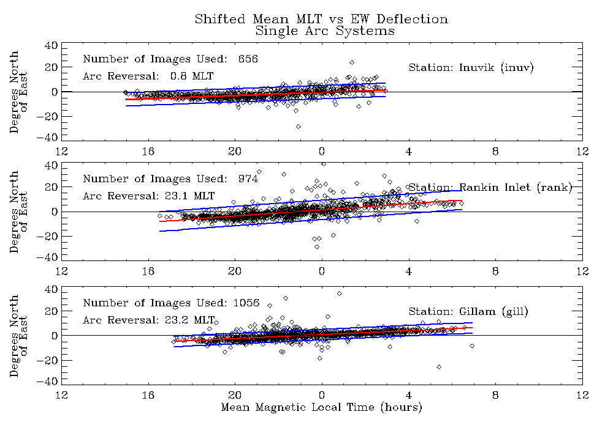
Single Arc Systems

Slide 11
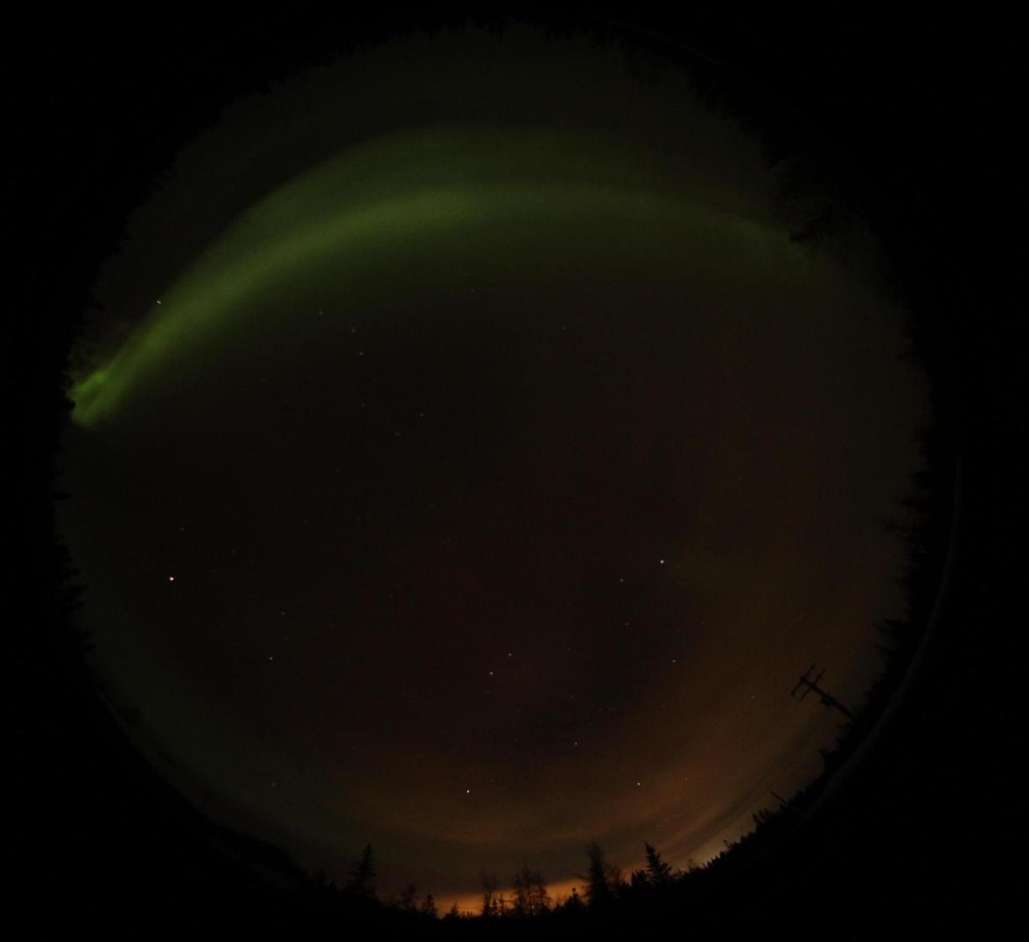
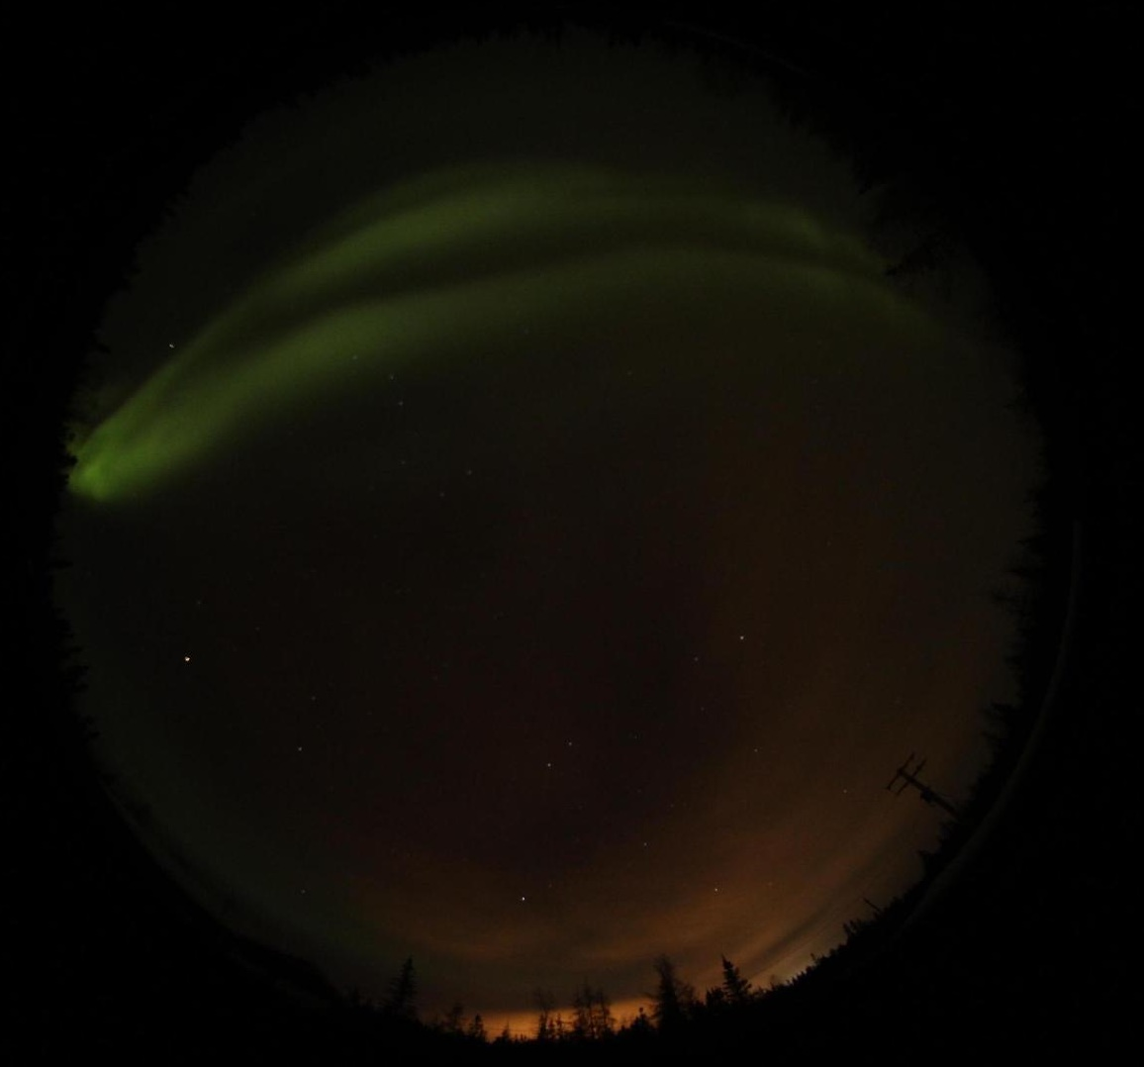
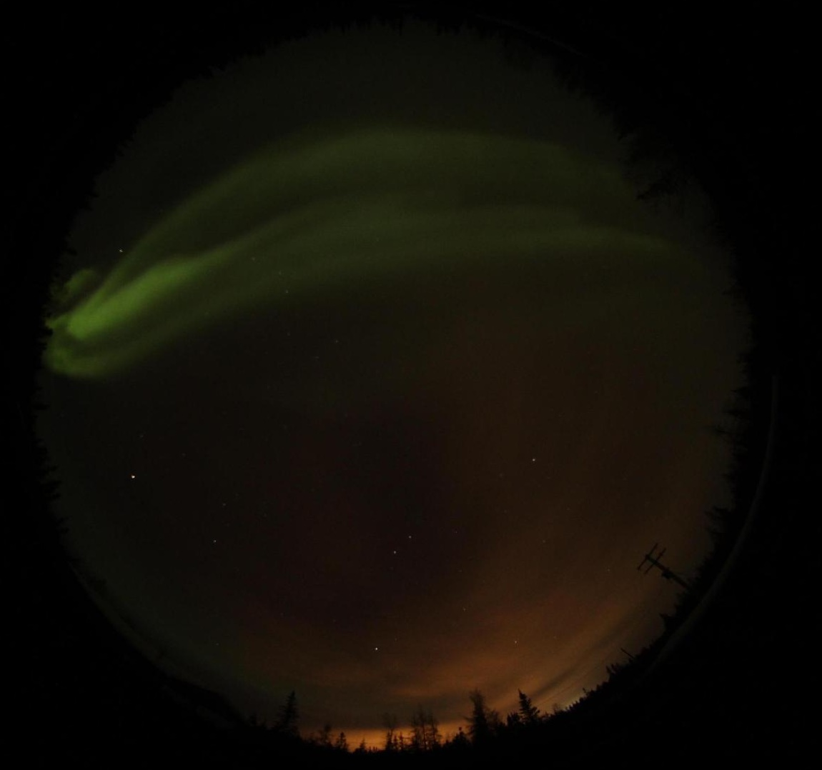
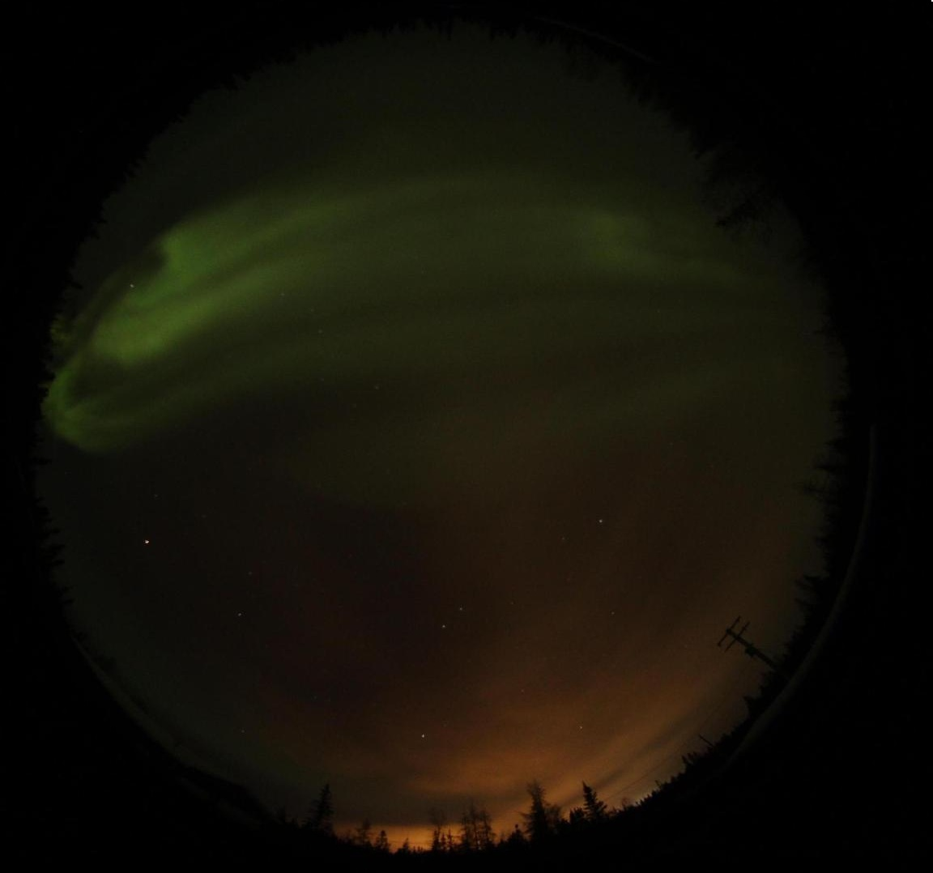
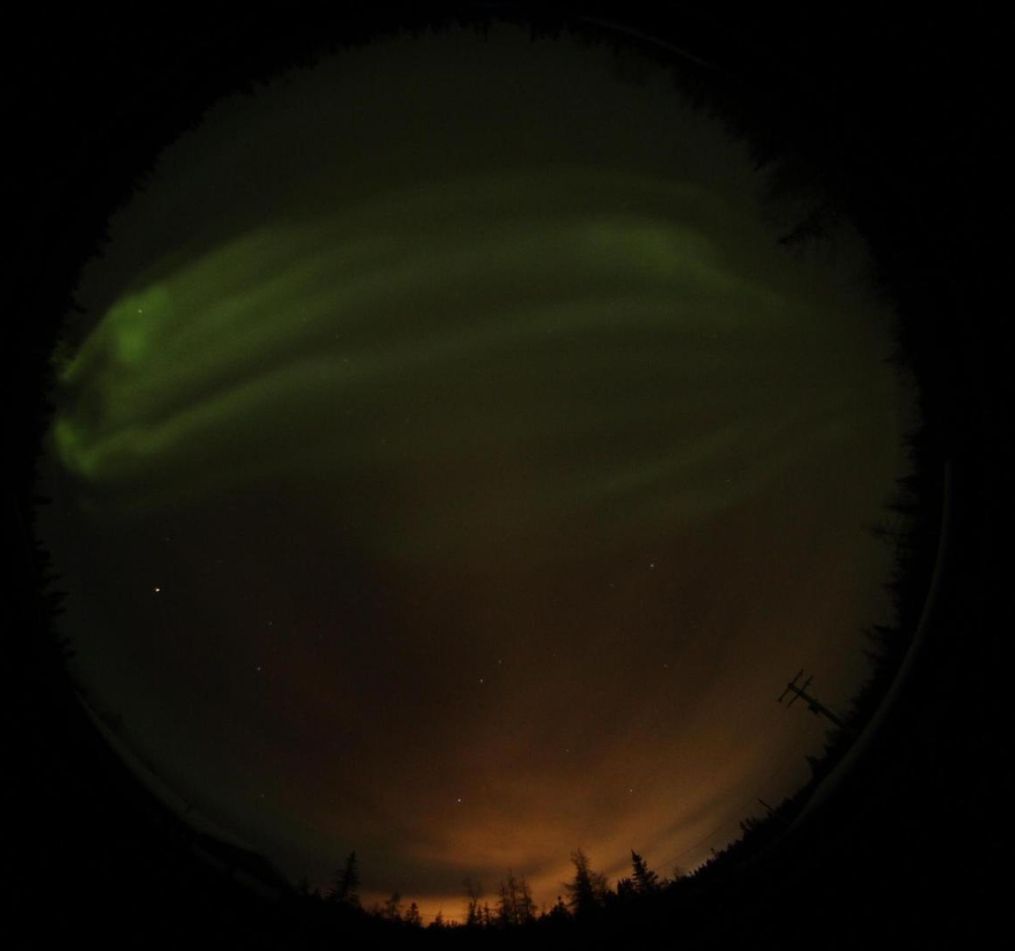
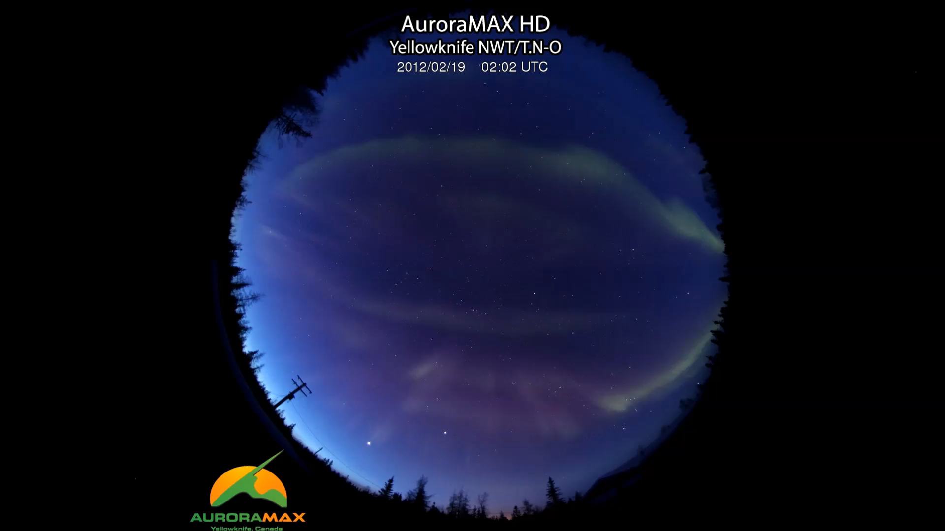
Multiple Arc Systems

Slide 12
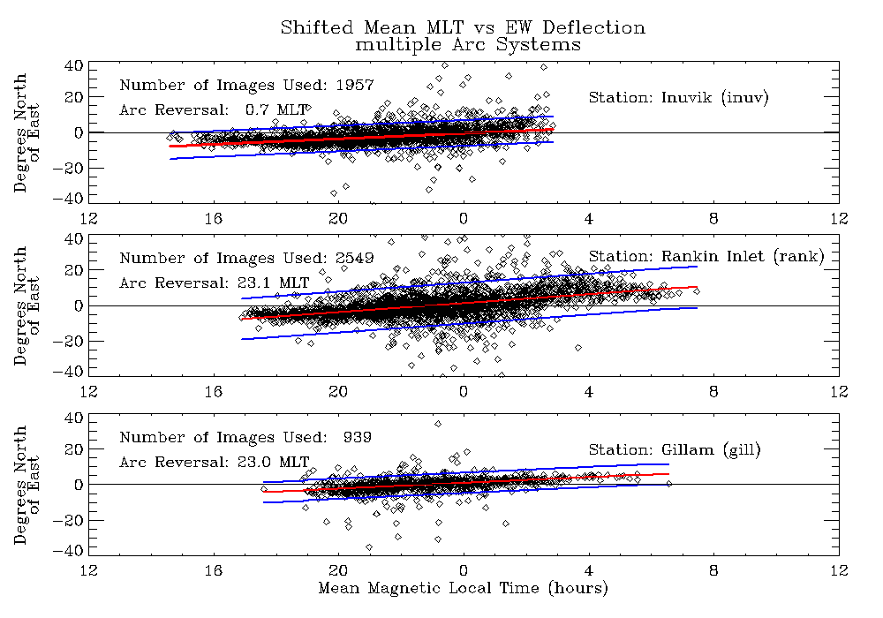

Slide 13
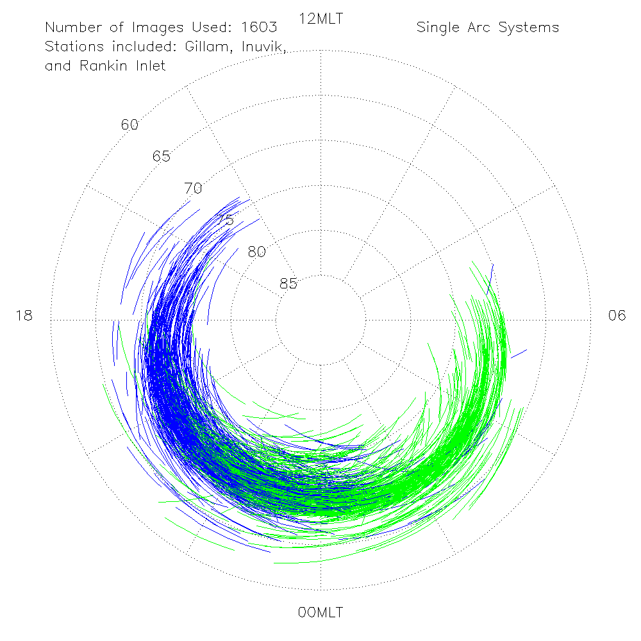
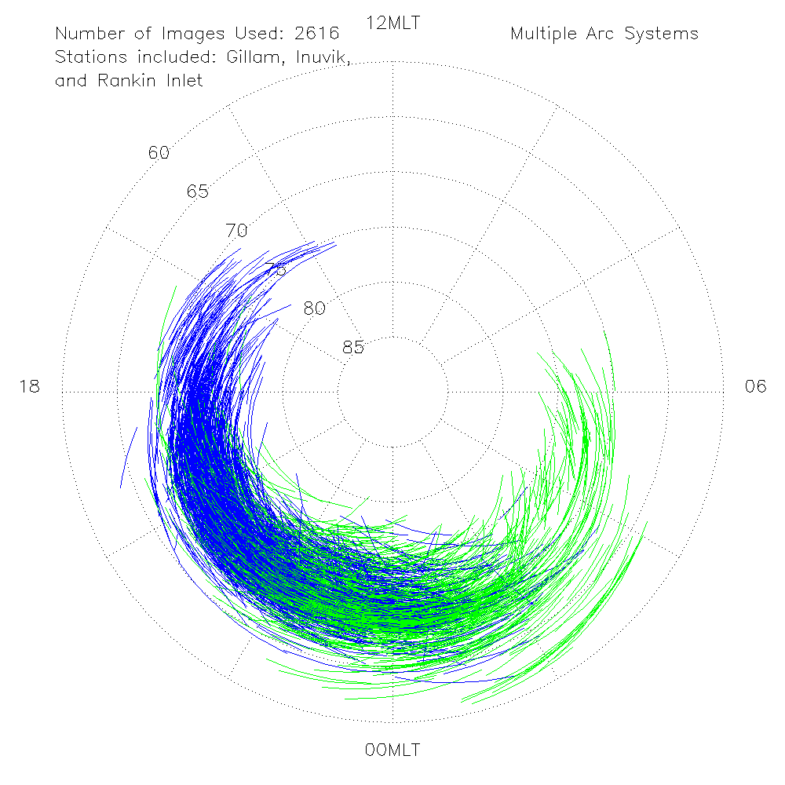
CQ: What is the current understanding of how those particular auroral forms are produced.
Notes:
We found that most stable arcs, regardless of identification with single‐ or multiple‐arc systems, were aligned with lines of constant geomagnetic latitude to within σ_{SD}=±7.7∘of east‐west alignment. This specific tilt suggests that arc morphology is imposed by large‐scale magnetospheric properties as opposed to more localized processes occurring in the auroral acceleration region or ionosphere. When arc alignment was characterized as a function of geomagnetic latitude and magnetic local time, a distinct pattern emerged. We showed that arc tilt strongly depends upon MLT for all latitudes studied. This is highly suggestive of the influence of the magnetotail orientation. Each station showed a distinct crossover point from poleward to equatorward tilt. Further study of this arc tilt reversal location yielded a shift in MLT position between single‐ and multiple‐arc systems. In association with multiple arcs occurring within more geomagnetically active periods, further investigation into the arc tilt reversal position and magnetotail stretching should be pursued.
Magnetotail Stretching is imposed on arc alignment.

Slide 14
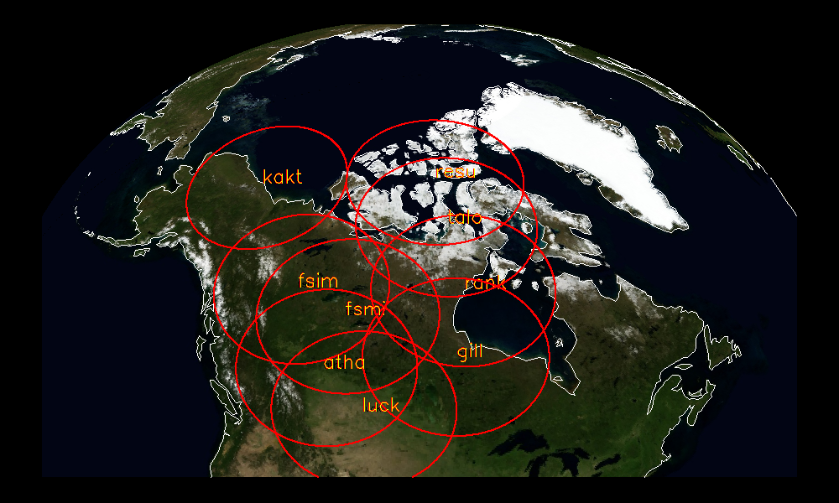
A statistical survey of the 630.0 nm optical signature of periodic auroral arcs resulting from magnetospheric field line resonances
D. Megan Gillies, David Knudsen, Robert Rankin, Steve Milan, and Eric Donovan
Submitted to GRL – currently under review
Notes:
ADD “UNDER REVIEW”

Slide 15
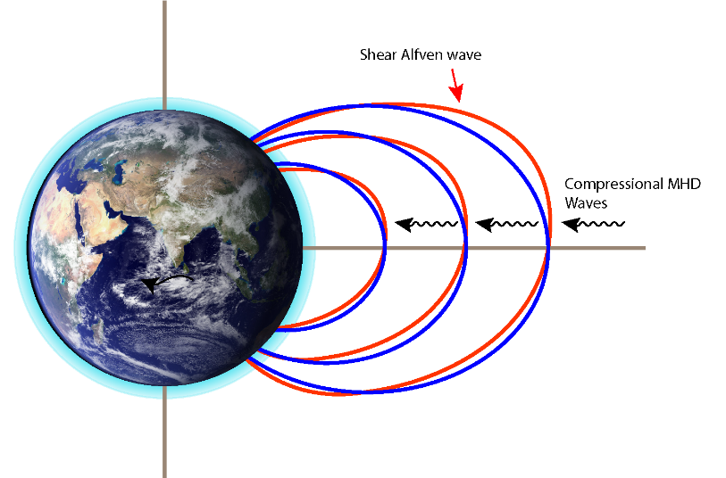
What is a “Field-line resonance?”
MHD theory gives two types: Compressional and Shear Alfvén waves.
According to theory standing shear alfven waves can be excited along geomagnetic field lines.
If the eigenfreqency matches the MHD wave frequency a resonance occurs.
It is a unique phenomenon which can be simultaneously observed in the magnetosphere and by magnetometers on the ground.
Occur with periods on the order of 5-15 minutes at auroral latitudes.
Period increases with latitude.
Often seen in magnetometers near dawn and dusk.
Notes:
So what is a field-line resonance?
FLRs are one of the few phenomena which can be seen simultaneously in the magnetosphere and by magnetometers on the ground. Its characterized by large scale oscillations of the geomagnetic field and has been extensively studies from a standing wave point of view.
For a standing wave analogy consider the geomagnetic field lines to be a violin string with both ends tethered in the ionosphere.
Magnetometers on the ground see FLRS as periodic perturbations of the local magnetic field, generally on the order of 5-10 mins.
The resonance occurs along closed magnetic field lines. Since magnetic field lines become longer as you move higher in altitude, the frequency tends to decrease the further north you go.

Slide 16
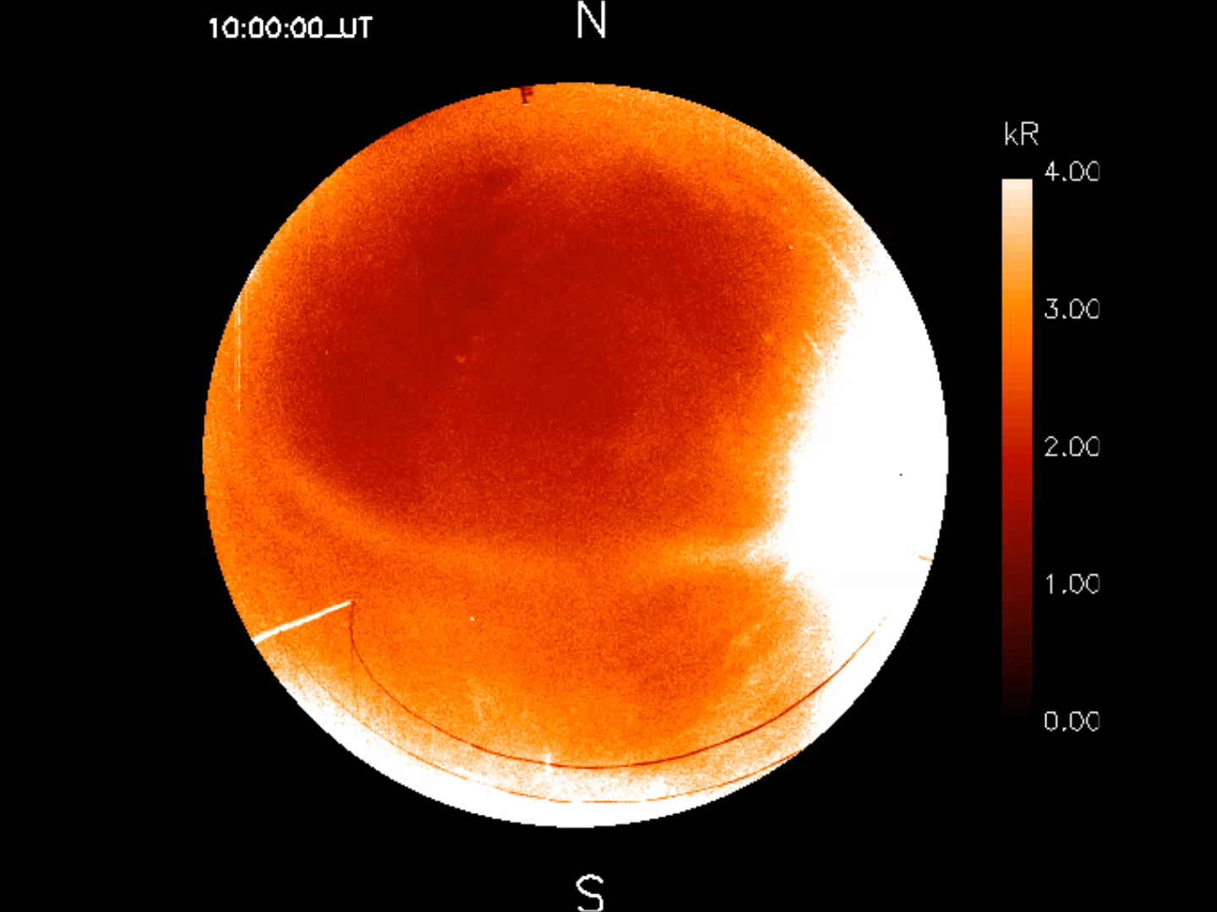
Optical FLRs
Gillam, Manitoba
February 2nd, 2015
~9-11 UT
Notes:
So what does a field-line resonance arc look like?
This is a compilation of images obtained from the REGO GILL ASI giving an example of how FLR appear in the optical data.
North is towards the top, south to the bottom. Bright patch on the right is the moon. Intensity is calibrated in Rayleighs.
As we can see an auroral arc forms at an initial latitude and slowly propagates north before fading. Subsequent arcs form at near the same initial latitude before following the same path.
This behavior tends to repeat on the order of ½ hr to 2 hrs with arcs appearing at 5-15 minute intervals.
These are difficult to identify in the THEMIS white light cameras, as I will show next.

Slide 17
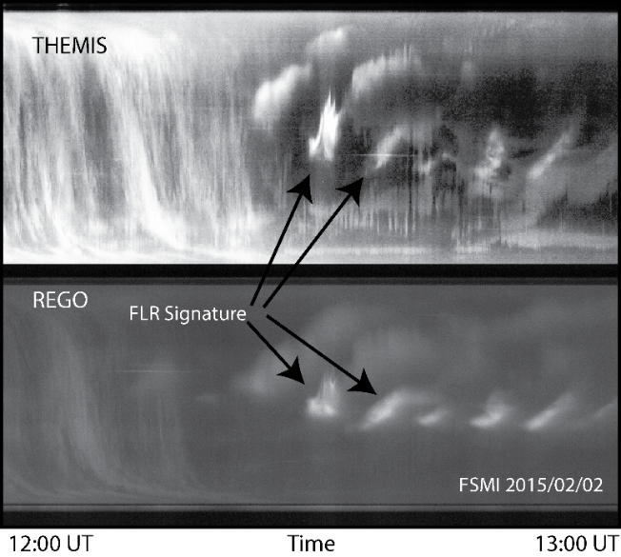
Notes:
How do we identify Optical FLRS?
Simplest approach is to use a keogram.
On the top here I’ve shown what an FLR arc looks like from the point of view of a themis “white” light camera. In this image we see a lot of features:
-clouds, FLR mixed with diffuse aurora, overlaid with strong pulsating patches
-I chose this particular event because you can actually still see the FLR arcs in the background of the “white” light image however this is not usually the case.
This is what an FLR looks like when filter out a lot of the brighter, higher energy emissions.
Smooth banded lines of long lived, slowly moving, auroral arcs beginning at lower altitudes and propagating northward. The subsequent arcs in the system originating in or near the initial arcs and following the same path.

Slide 18
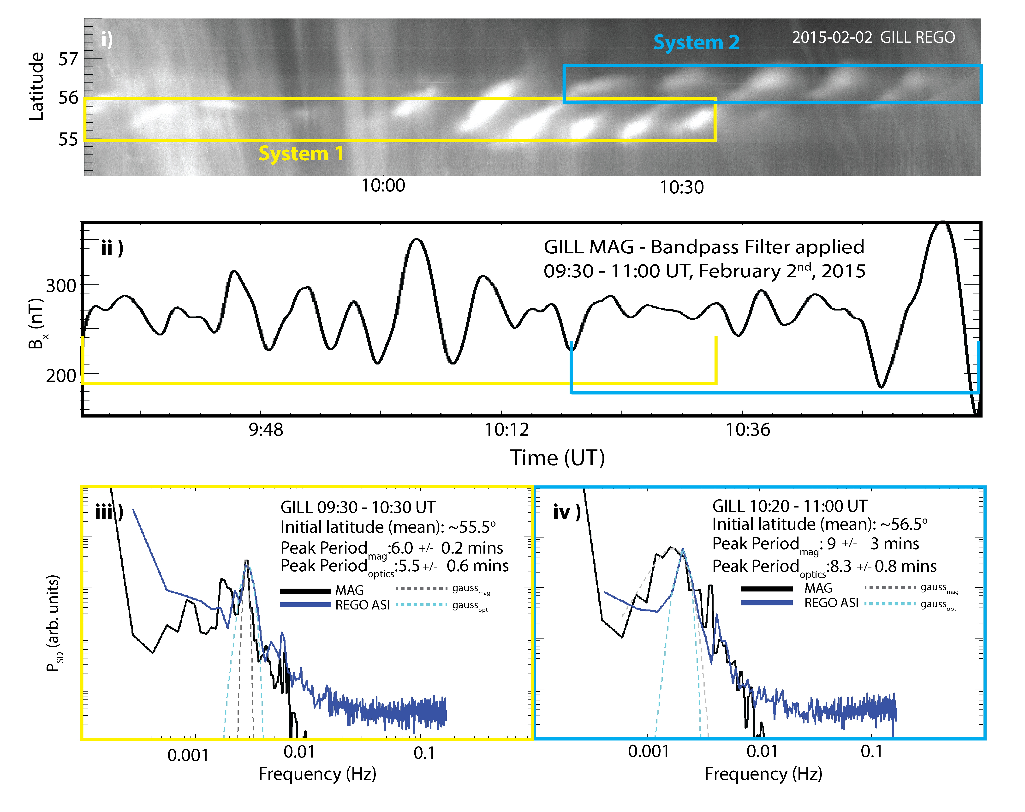
Notes:
So how do I now determine if these arcs are just a steady multiple arc system or a true optical representation of a magnetospheric FLR?
I had mentioned earlier that FLRs can be seen in ground based magnetometers.
So how do these arcs compare to what the magnetometers see? To show you now I have picked an event where there are two distinctly different FLR arc systems identified with the REGO ASI at Gillam MB and compared the arcs to what we see from the magnetometers.
In the keogram we have the two systems and we can see the characteristic morphology associated with FLR arcs. In this panel I am showing the x component of the geomagnetic field from a collocated magnetometer.
After performing a Fourier analysis on the optical data and, the magnetometer data, we can see marked similarities between the two data sets.
Lets look at the first system. The black line represents the results of our Fourier analysis on the magnetometer. From this we see that there is a peak frequency of about six minutes. The same analysis is performed on the optics, and illustrated by the purple line, and we see that the arcs also seem to have a preferred periodicity of around six minutes.
When you consider the second system, we can again see similar periodicities between the magnetometer and the ASI data sets, with the peak period being roughly 8 minutes.
The slightly longer period of the second system reflects FLR behavior frequently seen by magnetometers. The second system is at a slightly higher latitude and that is reflected in the longer period.

Slide 19
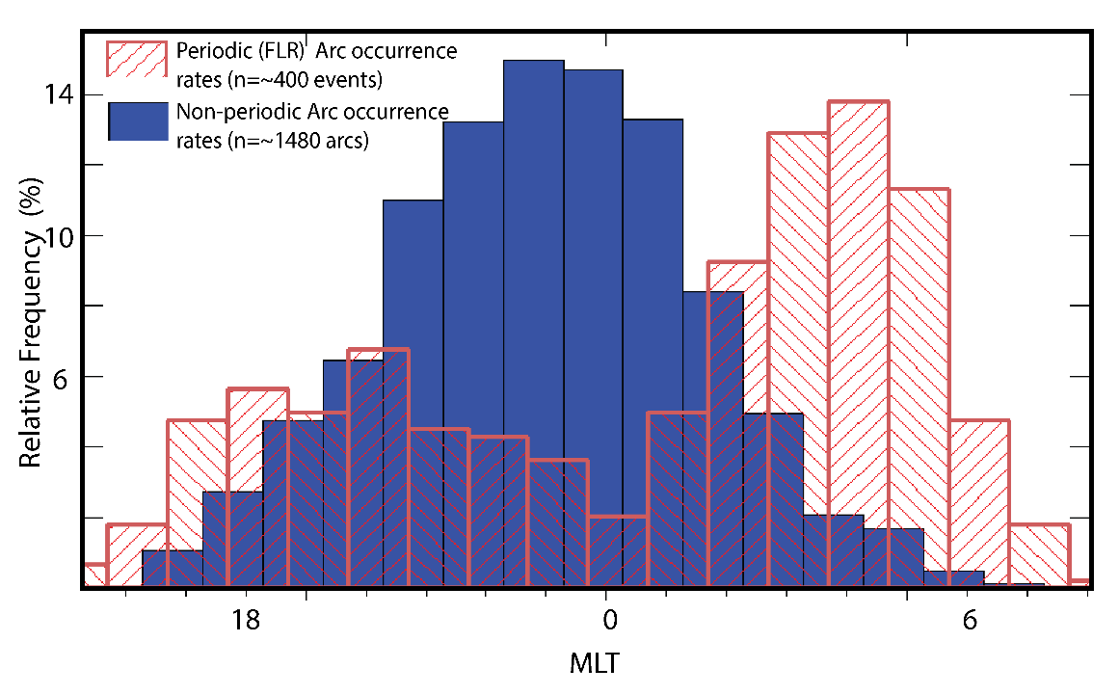
CQ: “When” and where do FLR arcs occur and how often?
Notes:
So how often do we actually see FLR arcs? Statistically speaking – FLR arcs are incredibly rare. The only occur in ~5% of REGO’s viewing data. To provide some context with respect to different arc morphologies: single and multiple arc systems are the most frequent. Making up the bulk of auroral observations. Pulsating aurora occurs in about 30% of 577.7 nm auroral observations, sometimes with other auroral morphologies or on its on.
Prior to the deployment of REGO, there less than ten cases studies of FLR arcs. Since it’s deployment in November 2014 until March 2016, keeping in mind that a large majority of the redline cameras do not operate in the summer months, we found nearly 440 clear, usable events. This is a 2 fold increase in magnitude of clear concise images of this particular arc morphology.
So to illustrate again that these are in fact a different type of arc system to multiple arcs I’d like to just take a look at how these arcs compare to the more standard or typical arc systems.
In this plot I’m comparing occurrence rate as a function of mlt of typical redline auroral arcs, such as single and multiple arcs to that of the FLR arcs. As you can see, the regular arcs peak in occurrence just before midnight, dropping off dramatically as you approach dawn. The FLR arcs more likely to be found in the hours leading up to dawn or around dusk.

Slide 20
Summary:
Single and Multiple arcs:
Observed across the night sector
Peak prior to magnetic (single and multiple systems)
The tilt of the auroral arc is highly related to MLT position
IMF Bx and By are factors in the MLT position of the tilt.
FLR:
FLRs are rare ~5% of the time aurora is present
‘Dim’: ~3 kR
FLR occurrence peaks just prior to dawn and just after midnight
  Discrete auroral arcs peak just prior to midnight

Slide 21
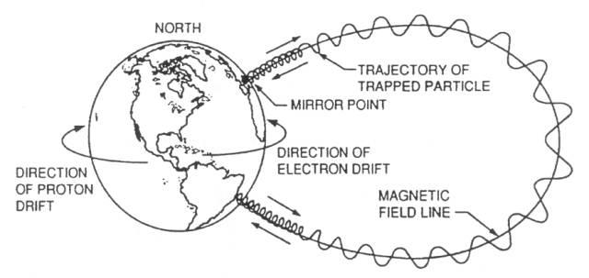
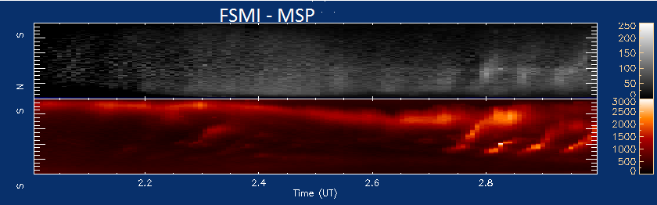
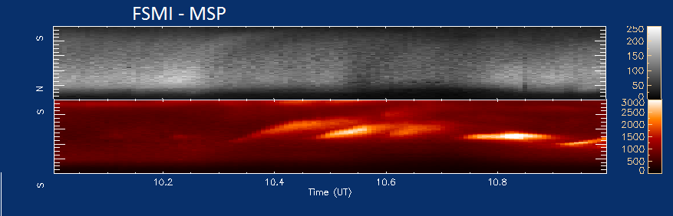

Slide 22
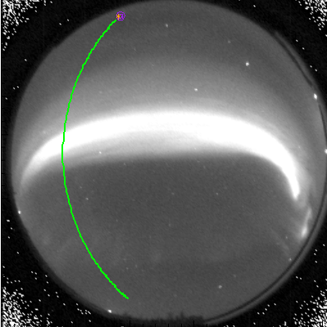
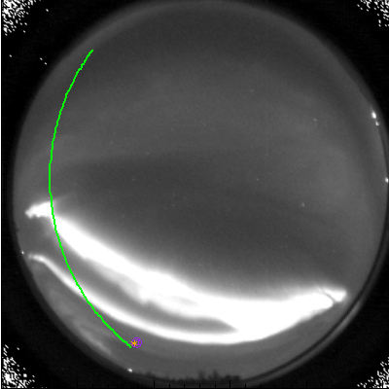
Single Arcs
Multiple Arcs
Field Line Resonance Arcs

Slide 23
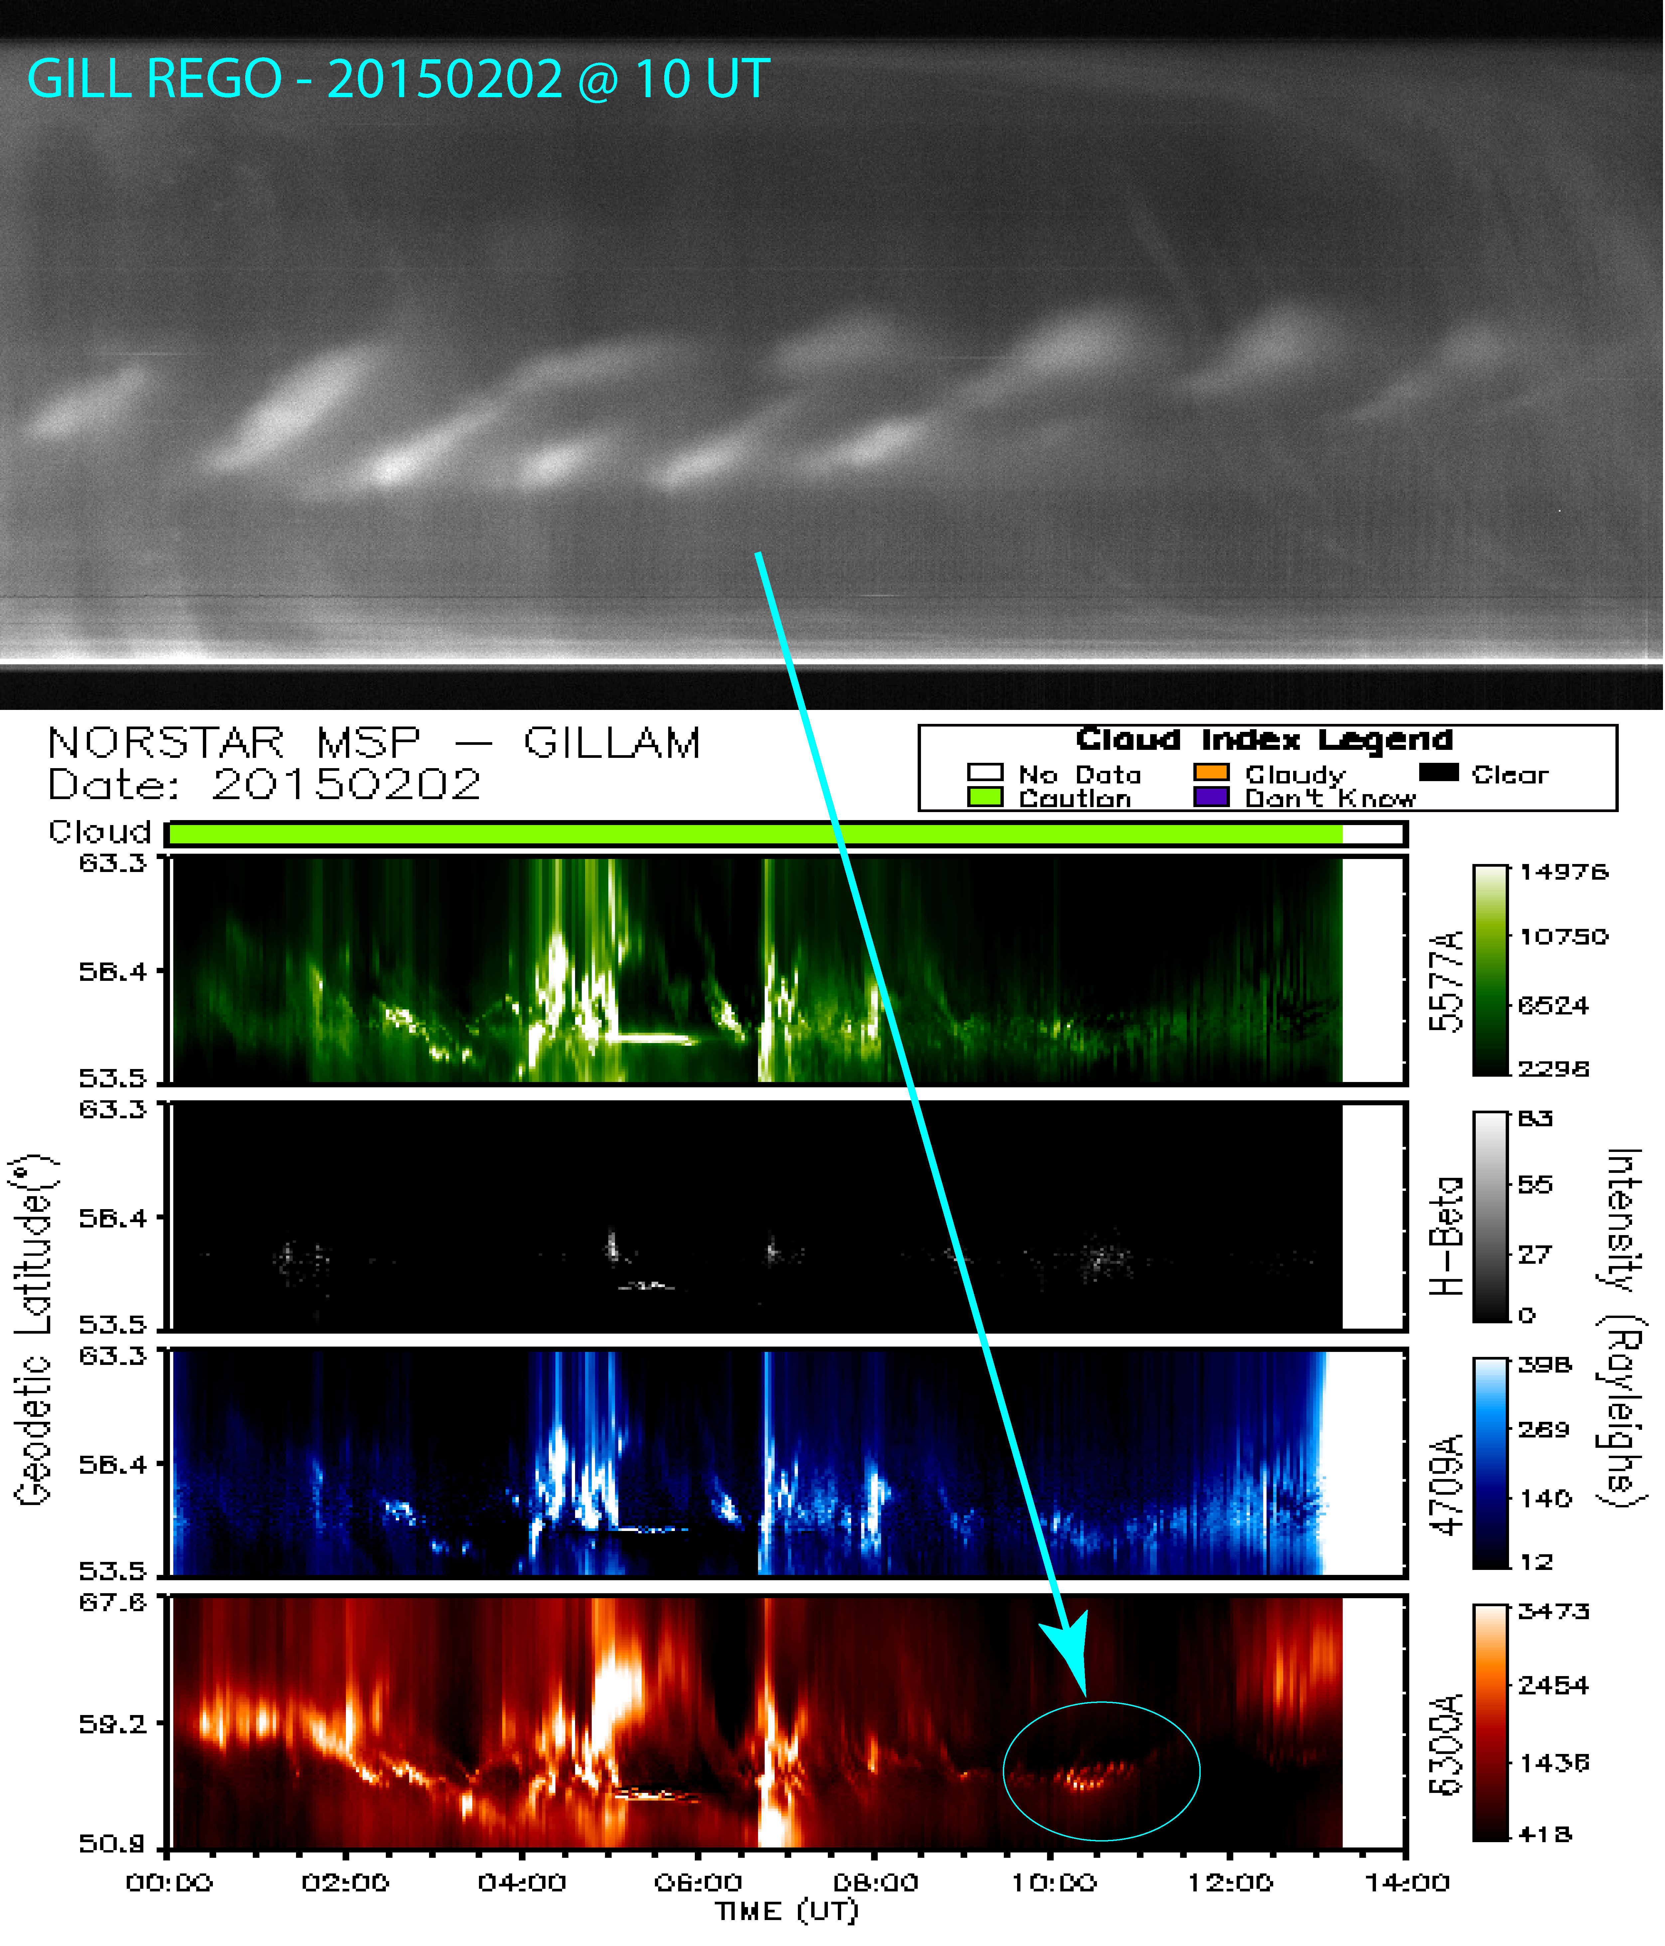
CQ: What is the current understanding of how those particular auroral forms are produced.
CQ: Is there near universal consensus or do important controversies remain?
  if the cause of the auroral form is controversial then what are the controversies?
  why have the controversies not been resolved?
  how will CONNEX resolve those controversies

Slide 24
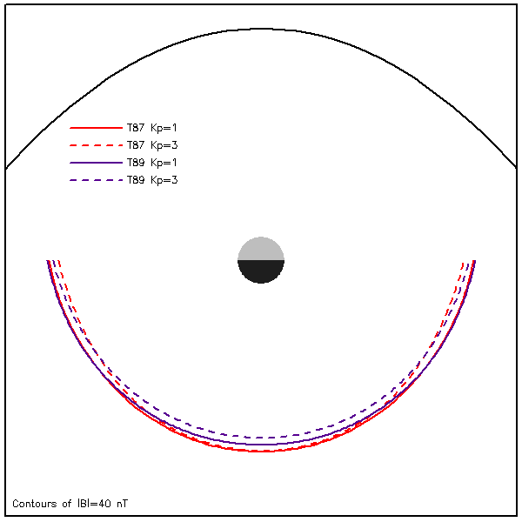
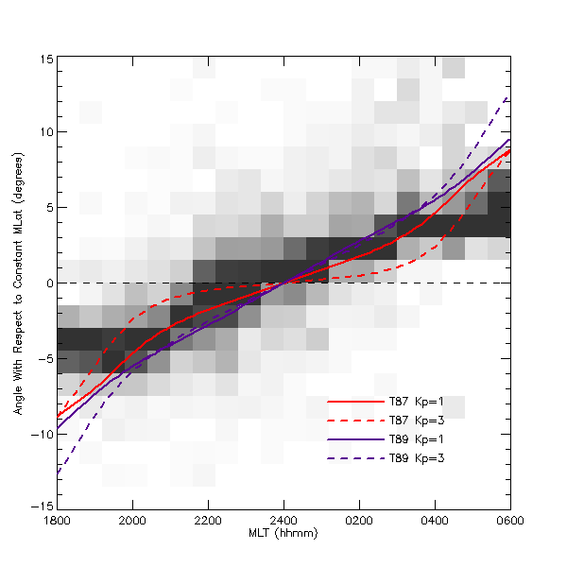
CQ: What is the current understanding of how those particular auroral forms are produced.
CQ: Is there near universal consensus or do important controversies remain?
Notes:
From these mapped curves, we can determine a local slope with respect to the local magnetic east‐west direction as a function of MLT.
Our primary point here is that the arc tilts show the same MLT dependence as does the slope of the contours of constant equatorial magnetic field strength mapped to ionospheric altitude. Further, the arc tilts show the same general MLT trend as does the slopes of the mapped contours of constant magnetic field strength using four different models that correspond (empirically) to the geomagnetic conditions during which quiet arcs are typically observed
This comparison strongly suggests that auroral arc morphology is indeed strongly tied to large‐scale magnetospheric properties as suggested earlier. In the current literature, it is strongly believed that auroral arcs are located along field lines threading the thin current sheet (TCS) [Sergeev et al., 2012; Yahnin et al., 1997]. In this study, however, we have found that there are arcs toward the noon sector. It is not thought that the TCS extends that far around the Earth, nor should the field line draping draw them that close to the postnoon sector. This interesting arc behavior will be further investigated in future research.
Theories: One notable example that does produce quiet, elongated, multiple parallel arc-like features is the so-called ionospheric feedback instability (IFI) model that has been in development for over 40 years. In
this theory, auroral arcs are spatial oscillations of ﬁeld-aligned current sheets that are oriented perpendicular to background plasma convection. In other words, large-scale magnetospheric convec tion provides the large-scale context that organizes arcs.
-IFI requires long time periods – arcs can appear in seconds.
-IFI centers arcs around dusk….this study shows a slightly different grouping set.
-Doesn’t include an electron acceleration mechanism (inverted V structure)
-Stationary Inertial alven waves are more likely to produce multiple arc structures can occur when large-scale plasma drift crosses large-scale, initially
unstructured FAC sheets assumed to be caused by some other mechanism, for example, magnetospheric
pressure gradients
-this theory accounts for multiple structures and provides the inverted v pattern but like the IFI cannot explain electron acceleration to 10keV.

Slide 25
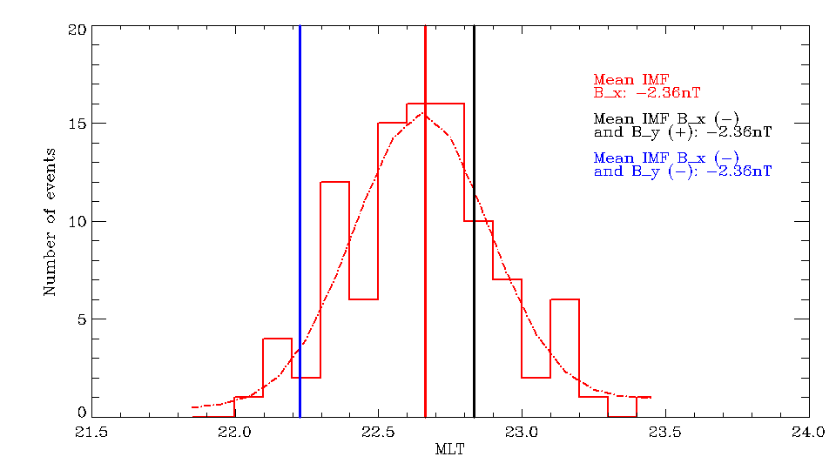
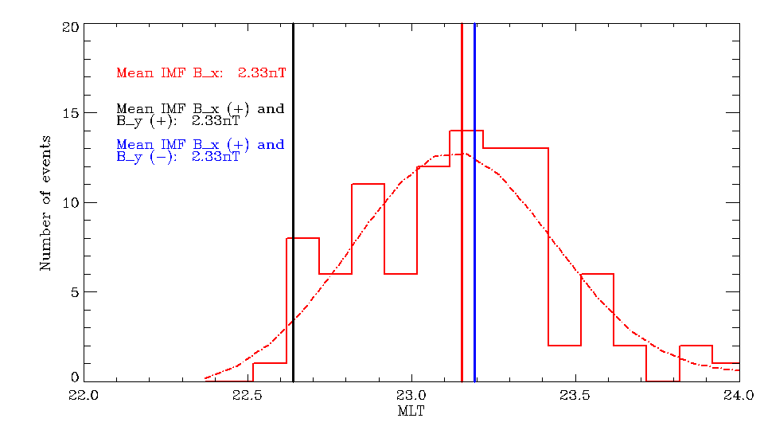
CQ: Is there near universal consensus or do important controversies remain?
IMF influence
Notes:
The IMF B_{x}and B_{y}components are most tightly tied to the Sun's Parker spiral behavior. We have established that the tilt of the arc is tightly tied to the auroral oval location, with equatorward tilt occurring on the duskside of the oval and poleward tilt occurring on the dawnside. In the event of a typical Parker spiral orientation of the IMF (B_{x}>0,B_{y}<0), it appears that the auroral oval is shifted toward dawn. In the event of an atypical anti‐Parker spiral IMF orientation (B_{x}>0,B_{y}>0) the oval appears to shift more toward the dusk. This portion of the study was only performed on single‐arc systems for the GILL station. Further analysis of the other stations, and expansion to include the multiple‐arc systems, has been left for future work. We have chosen our events by looking specifically for stable auroral arc structures.
A large majority of these events are therefore considered presubstorm stable arc structures. Liou et al. [2001] performed a study on the IMF effects on the location of the auroral arc substorm. In that study, Liou et al. [2001] used the Polar ultraviolet imager and Wind observations to study the location of a significant number of well‐defined auroral arc breakups. Coupled with the IMF conditions surrounding these auroral breakups (substorm onsets) they concluded that there was in fact a weak dependence upon the substorm onset location (in MLT) and the IMF orientation. Identical behavior to that seen here was noted with respect to the shift in substorm onset location. This study, using a much larger data set and alternative approach, confirms their findings regarding a MLT dependence and loosely ties auroral arc formation to substorm onset.

Slide 26
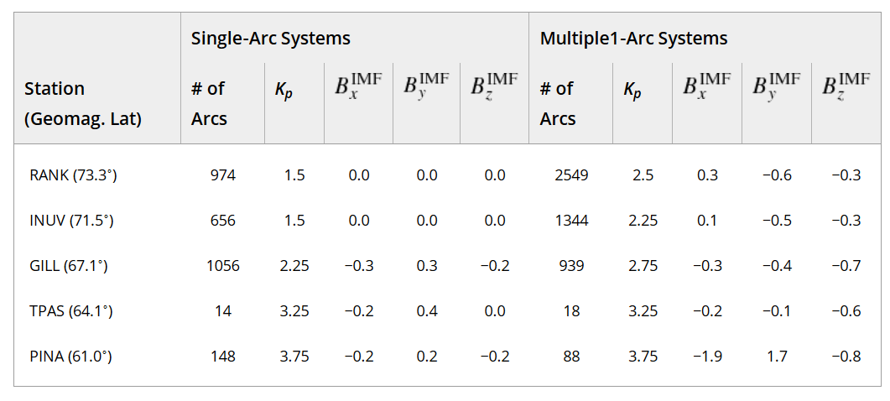
CQ: Where (in the ionosphere) and when (under what general conditions) do those auroral forms occur?
8a)
8b)

